Slide 1
CISSP® Common Body of Knowledge Review: Software Development Security Domain
Version: 5.10

Slide 2
Learning Objective Software Development Security Domain
Software Development Security domain refers to the controls that are included within systems and application software and the steps used in their development (e.g., SDLC).
Software refers to system software (operating systems) and application programs such as agents, applets, software, databases, data warehouses, and knowledge-based systems. These applications may be used in distributed or centralized environments.
The candidate should fully understand the security and controls of the system development process, system life cycle, application controls, change controls, data warehousing, data mining, knowledge-based systems, program interfaces, and concepts used to ensure data and application integrity, security, and availability.
Reference: CISSP CIB, January 2012 (4.17.14 Rev. 13)

Slide 3
Introduction Current State of Insecurity in Federal Agencies
“The 25 major agencies of Federal government continue to improve information security performance relative to C&A rate and testing of contingency plans and security controls.” – OMB FY 2008 Report to Congress on Implementation of FISMA.
Yet, “20 of 24 major agencies indicated that inadequate information security controls were either a significant deficiency or a material weakness.”*
% of System with a: | FY 2005 | FY 2006 | FY 2007 | FY 2008
Certification and Accreditation (C&A) | 85% | 88% | 92% | 96%
Tested Contingency Plan | 61% | 77% | 86% | 92%
Tested Security Controls | 72% | 88% | 95% | 93%
Total Systems Reported | 10,289 | 10,595 | 10,304 | 10,679
* Source: GAO-08-496, Information Security– Although Progress Reported, Federal Agencies Need to Resolve Significant Deficiencies, February 14, 2008
Notes:
Unauthorized Access: identification and authentication of users are not consistently enforced… a systems engineering problem.
Improper Usage: Information assets are not always identified and inventoried… another security engineering problem. We don’t always know the level of protection necessary. One thing that DoD does pretty well is having a security classification guide for each project.
Under investigation: Those are the incidents that nobody knows exactly the cause and impact. During May of ‘08, MITRE’s Bill Neugent had presented a talk to my sponsor – IRS on the fact that cyber threats are getting more “sophisticated” – no longer just hackers, we now have insiders, organized crime, terrorists, criminals perpetrating fraud. Security engineers needs to understand the MISSION, BUSINESS OBJECTIVES, and OPERATIONAL PROCESSES.

Slide 4
Introduction Current State of Insecurity in Federal Agencies
# of security incidents keeps growing*…
What happened here?
* Source: US-CERT
Notes:
Unauthorized Access: identification and authentication of users are not consistently enforced… a systems engineering problem.
Improper Usage: Information assets are not always identified and inventoried… another security engineering problem. We don’t always know the level of protection necessary. One thing that DoD does pretty well is having a security classification guide for each project.
Under investigation: Those are the incidents that nobody knows exactly the cause and impact. During May of ‘08, MITRE’s Bill Neugent had presented a talk to my sponsor – IRS on the fact that cyber threats are getting more “sophisticated” – no longer just hackers, we now have insiders, organized crime, terrorists, criminals perpetrating fraud. Security engineers needs to understand the MISSION, BUSINESS OBJECTIVES, and OPERATIONAL PROCESSES.

Slide 5
Introduction Current State of Insecurity in COTS Software
The software flaw statistics are also trending upward…
According to an analysis by Software Engineering Institute (SEI): “Most software security vulnerabilities arise from common causes; more than 90 percent are caused by known software defect types.” Where the top 10 causes account for about 75 percent of all vulnerabilities.
* Source: National Vulnerability Database (http://nvd.nist.gov)

Slide 6
Introduction 2011 CWE/SANS Top 25 Most Dangerous Programming Errors
Rank | Score | ID | Name
[1] | 93.8 | CWE-89 | Improper Neutralization of Special Elements used in an SQL Command ('SQL Injection')
[2] | 83.3 | CWE-78 | Improper Neutralization of Special Elements used in an OS Command ('OS Command Injection')
[3] | 79.0 | CWE-120 | Buffer Copy without Checking Size of Input ('Classic Buffer Overflow')
[4] | 77.7 | CWE-79 | Improper Neutralization of Input During Web Page Generation ('Cross-site Scripting')
[5] | 76.9 | CWE-306 | Missing Authentication for Critical Function
[6] | 76.8 | CWE-862 | Missing Authorization
[7] | 75.0 | CWE-798 | Use of Hard-coded Credentials
[8] | 75.0 | CWE-311 | Missing Encryption of Sensitive Data
[9] | 74.0 | CWE-434 | Unrestricted Upload of File with Dangerous Type
[10] | 73.8 | CWE-807 | Reliance on Untrusted Inputs in a Security Decision
[11] | 73.1 | CWE-250 | Execution with Unnecessary Privileges
[12] | 70.1 | CWE-352 | Cross-Site Request Forgery (CSRF)
[13] | 69.3 | CWE-22 | Improper Limitation of a Pathname to a Restricted Directory ('Path Traversal')
[14] | 68.5 | CWE-494 | Download of Code Without Integrity Check
[15] | 67.8 | CWE-863 | Incorrect Authorization
[16] | 66.0 | CWE-829 | Inclusion of Functionality from Untrusted Control Sphere
[17] | 65.5 | CWE-732 | Incorrect Permission Assignment for Critical Resource
[18] | 64.6 | CWE-676 | Use of Potentially Dangerous Function
[19] | 64.1 | CWE-327 | Use of a Broken or Risky Cryptographic Algorithm
[20] | 62.4 | CWE-131 | Incorrect Calculation of Buffer Size
[21] | 61.5 | CWE-307 | Improper Restriction of Excessive Authentication Attempts
[22] | 61.1 | CWE-601 | URL Redirection to Untrusted Site ('Open Redirect')
[23] | 61.0 | CWE-134 | Uncontrolled Format String
[24] | 60.3 | CWE-190 | Integer Overflow or Wraparound
[25] | 59.9 | CWE-759 | Use of a One-Way Hash without a Salt
Reference: http://cwe.mitre.org/top25/

Slide 7
Introduction Today’s problems are about same as yesterday’s
Open Web Application Security Project (OWASP) Top 10
2010 | 2013
A1 – Injection | A1 – Injection
A3 – Broken Authentication and Session Management | A2 – Broken Authentication and Session Management
A2 – Cross-Site Scripting (XSS) | A3 – Cross-Site Scripting (XSS)
A4 – Insecure Direct Object References | A4 – Insecure Direct Object References
A6 – Security Misconfiguration | A5 – Security Misconfiguration
A7 – Insecure Cryptographic Storage – Merged with A9 → | A6 – Sensitive Data Exposure
A8 – Failure to Restrict URL Access – Broadened into → | A7 – Missing Function Level Access Control
A5 – Cross-Site Request Forgery (CSRF) | A8 – Cross-Site Request Forgery (CSRF)
<buried in A6: Security Misconfiguration> | A9 – Using Known Vulnerability Components
A10 – Un-validated Redirects and Forwards | A10 – Un-validated Redirects and Forwards
A9 – Insufficient Transport Layer Protection | Merged with 2010-A7 into new 2013-A6
Source: OWASP Top Ten Project (https://www.owasp.org/index.php/Category:OWASP_Top_Ten_Project)

Slide 8
Topics Software Development Security Domain
Governance & Management
System Life Cycle and Security
Software Environment and Security Controls
Programming Languages
Database and DB Warehousing Vulnerabilities, Threats, and Protections
Software Vulnerabilities and Threats

Slide 9
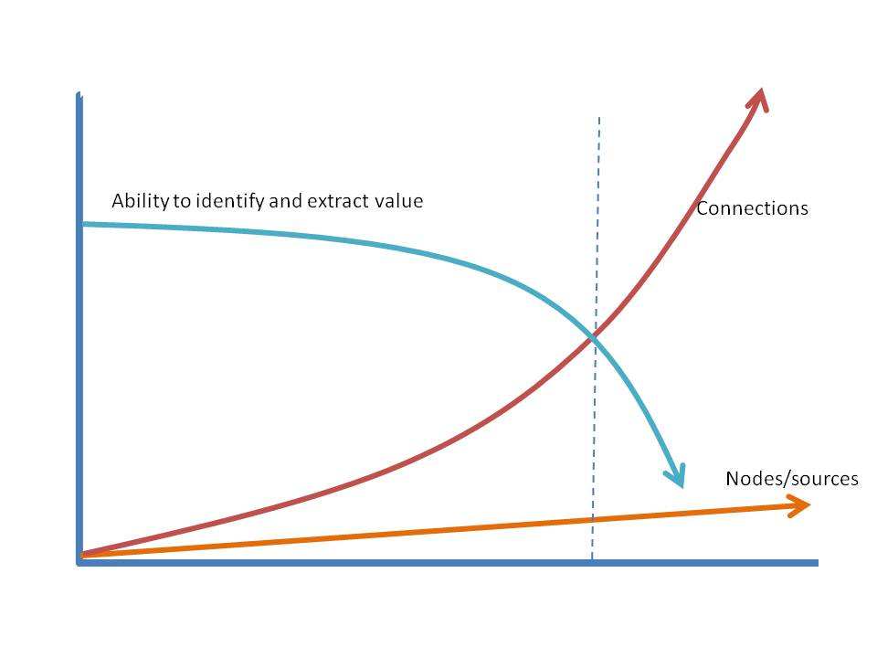
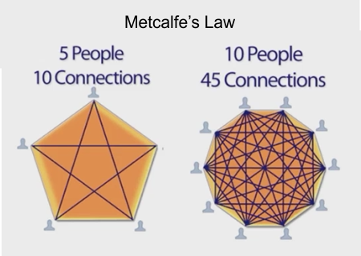
Governance & Management Size Matters… (1/2)
Number of connections (or interfaces) = n * (n – 1) / 2
Reference: Code Complete: A Practical Handbook of Software Construction, 2nd Edition, 2004

Slide 10
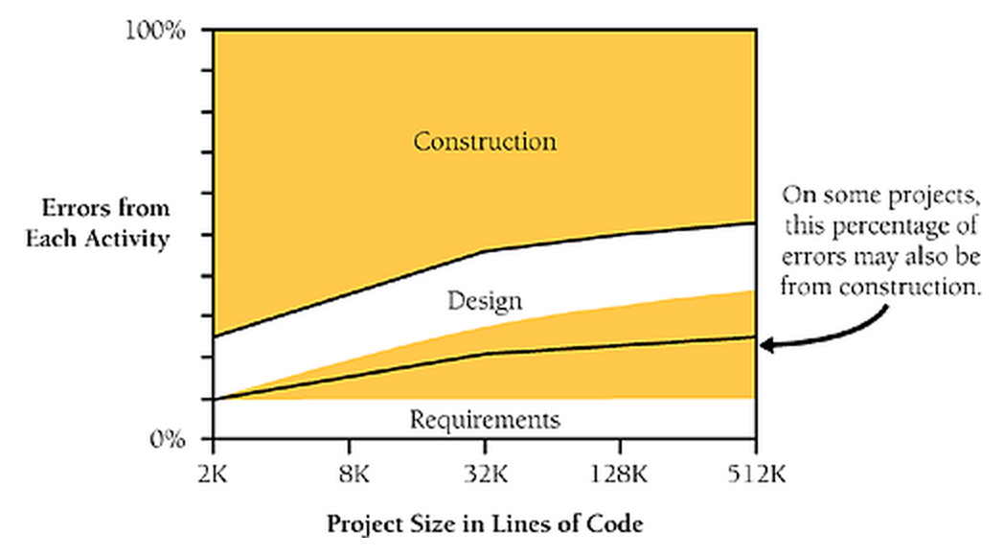
Governance & Management Size Matters… (2/2)
“As project size increases, errors usually come more from requirements and design… (Boehm 1981, Grady 1987, Jones 1998)”
Reference: Code Complete: A Practical Handbook of Software Construction, 2nd Edition, 2004

Slide 11
Governance & Management Information Security Governance
Policy. Management directives that establish expectations (goals & objectives), and assign roles & responsibilities.
Standards. Functional specific mandatory activities, actions, and rules.
Procedure. Step-by-step implementation instructions.
Baseline (or Process). Mandatory description of how to implement security packages to ensure consist security posture.
Guidelines. General statement, framework, or recommendations to augment baselines or procedures.

Slide 12
Governance & Management Clinger-Cohen Act of 1996 (CCA)
The Clinger-Cohen Act of 1996 (a.k.a. ITMRA) defined the Federal agencies and DoD’s acquisition, management, and usage of IT.
Key Elements
Defines the roles & responsibilities of Federal agencies and their executives (i.e. directors and CIOs.)
Requires Federal agencies to implement performance and result-based management for capital planning and investment control (CPIC).
Defines the IT acquisition process.
Requires IT architecture be defined for all Federal agencies. (i.e. Federal Enterprise Architecture (FEA)).
Notes:
Clinger-Cohen Act of 1996, a.k.a. Information Technology Management Reform Act (ITMRA).
CCA is important because it defines Federal agencies and DoDs acquisition, management and usage of information technology (IT).
In summary…
CCA defines the roles and responsibilities of Federal agencies and their executives.
It requires Federal agencies to implement earned-value management (EVM) for capital planning and investment control (CPIC).
It defines the IT acquisition process. (i.e. FAR, DFARS)
Question: Do anybody know what is FAR?
Answer: Federal Acquisition Regulation (FAR)
Question: And DFARS?
Answer: Defense Federal Acquisition Regulation Supplement (DFARS)
Finally, CCA requires all Federal agencies to define, maintain, and implement a sound and integrated IT architecture i.e. Federal Enterprise Architecture (FEA).

Slide 13
Governance & Management Why CCA (/ ITMRA) necessary?
In 1992, GAO reported: “Defense’s mission-critical systems continue to have significant software development problems. Numerous GAO reports and Defense studies have identified many problems, including a lack of management attention, ill-defined system requirements, and inadequate testing. The highly complex nature of mission-critical systems and millions of lines of software required to support them contribute to the continuation of serious software development problems.” E.g., *
Cheyenne Mountain Upgrade (CMU), etc.
Strategic Defense Initiative (SDI)
Patriot surface-to-air missile system (Patriot)
Army Tactical Command and Control System (ATCCS)
AN/BSY-2 combat system for SSN-21 Seawolf submarine (BSY-2)
AN/FQ-93 computer for the North American Aerospace Defense Command
C-17 transport aircraft
F-14D Tomcat fighter aircraft, etc.
Reference:
* GAO/IMTEC-93-13, Defense Attempting to Address Major Software Challenges, December 24, 1992

Slide 14
Governance & Management Federal Enterprise Architecture (FEA) Framework
Federal Enterprise Architecture Framework (FEAF) focuses on BUSINESS
Reference: Federal Enterprise Architecture Consolidated Reference Model, May 2005

Slide 15
Governance & Management COBIT Governance Framework
Control Objectives for Information and related Technology (COBIT) is an IT Governance Framework created by Information Systems Audit and Control Association (ISACA)
COBIT controls can encompass:
Information security controls (e.g., NIST SP 800-53, CNSS 1253, ISO/IEC 27001:2005)
IT processes management frameworks (e.g., ITIL, CMMI, ISO/IEC 27000 IT Service Management, PMBOK)
COBIT governance is composed of 5 focus areas:
Strategic alignment
Value delivery
Resource management
Risk management
Performance measurement
Reference: COBIT 4.1 (http://www.isaca.org/)

Slide 16
Governance & Management Augment IT Governance with Information Security
Information security is an ubiquitous practice…
Interrelationship of COBIT Components…
InfoSec Controls:
Management
Operational
Technical
Reference: COBIT 4.1 (http://www.isaca.org/)

Slide 17
System Life Cycle (SLC) and System Development Life Cycle (SDLC) ISO/IEC 12207:2008, Software Life Cycle Processes
* Note: ISO/IEC 12207is identical to IEEE Std 12207
Reference: IEEE/IEC 12207:2008, Information Technology Software Life Cycle Processes

Slide 18
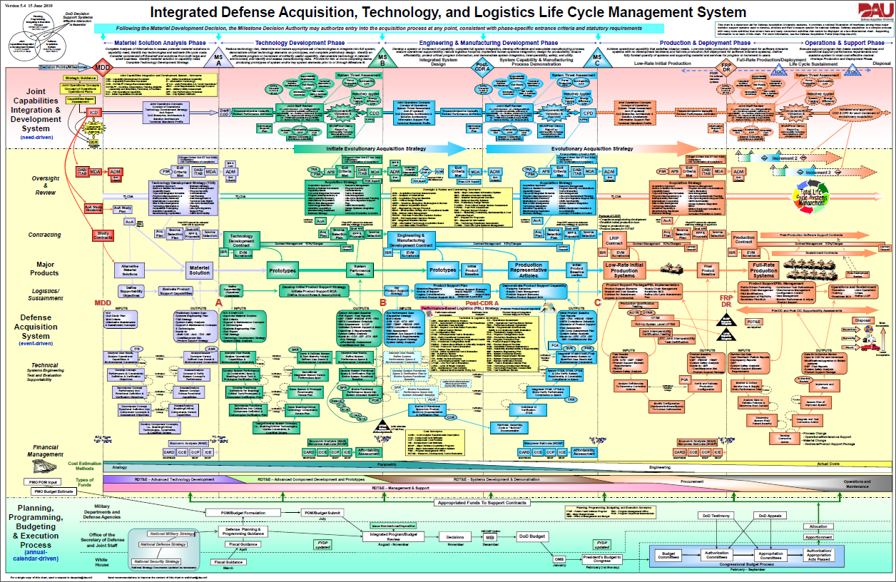
Governance & Management Life Cycle Stages in Defense Acquisition System
* Source: Integrated Life Cycle Chart (https://ilc.dau.mil/)

Slide 19
Governance & Management Each Life Cycle Stage has Milestone & Review

Slide 20
Governance & Management Governance & SE reduces Acquisition Risks
By Development Stage, 85% of LCC has already been committed.*
Ratio of structural/design defects (flaws) vs. implementation weaknesses (bugs) is 50:50.**
If structural/design flaws have not been discovered, mitigating them will add 20 to 100 times to the plan cost. (And up to 1000 x in Production/Test Stage.)*
Running source code analysis tools doesn’t help, because they are mostly for finding implementation weaknesses.**
Reference:
* INCOSE Systems Engineering Handbook, Version 3.2, 2010.
** G. McGraw, Software Security: Building Security In, Addison-Westley Professional, 2006. (ISBN: 978-0321356703)

Slide 21
Governance & Management Capability Maturity Model (CMM) – History
In 1986, Software Engineering Institute (SEI) and MITRE began developing an assessment framework for measuring the maturity of an organization’s [system/] software engineering process.
Process capability describes expected results.
Process performance represents the actual results achieved.
Process maturity is the degree which a process is explicitly defined, managed, measured, controlled, and effective.
* Reference: M. Paulk, et al, The Capability Maturity Model: Guidelines for Improving the Software Process, Addison-Wesley, 1995. (ISBN: 0-201-54664-7)

Slide 22
Governance & Management Software Capability Maturity Model (SW-CMM)
Level 1: Initial
The software development process is characterized as ad-hoc. Success depends on individual effort and heroics.
Level 2: Repeatable
Basic project management (PM) processes are established to track performance, cost, and schedule.
Level 3: Defined
Tailored software engineering and development processes are documented and used across the organization.
Level 4: Managed
Detailed measures of product and process improvement are quantitatively controlled.
Level 5: Optimizing
Continuous process improvement is institutionalized.

Slide 23
Governance & Management ISO/IEC 21827: SSE-CMM …(1/2)
System Security Engineering – Capability Maturity Model (SSE-CMM)
Notes:
As with all the CMM models, it is measured by a set of defined practice areas. For SSE-CMM, the practices are divided into two domains: Security Base Practices and Project & Organization Base Practices.
In the Security Base Practices domain, we have 11 practices which are very much captured in our ISSE Process.
In the Project & Organizational Base Practices, we also have 11 practices which are some what captured in PMBOK.

Slide 24
Governance & Management ISO/IEC 21827: SSE-CMM …(2/2)
SSE-CMM is composed of two domains:
Security Base Practice (11 x Process Areas)
Project & Organizational Base Practice (11 x Process Areas)
Security Base Practices
Administer Security Controls
Assess Impact
Assess Security Risk
Assess Threat
Assess Vulnerability
Build Assurance Argument
Coordinate Security
Monitor Security Posture
Provide Security Input
Specify Security Needs
Verify & Validate Security
Project & Organizational Base Practices
Ensure Quality
Manage Configuration
Manage Project Risks
Monitor & Control Technical Effort
Plan Technical Effort
Define Organization’s SE Process
Improve Organization’s SE Process
Manage Product Line Evolution
Manage SE Support Environment
Provide Ongoing Skills & Knowledge
Coordinate with Suppliers
Notes:
As with all the CMM models, it is measured by a set of defined practice areas. For SSE-CMM, the practices are divided into two domains: Security Base Practices and Project & Organization Base Practices.
In the Security Base Practices domain, we have 11 practices which are very much captured in our ISSE Process.
In the Project & Organizational Base Practices, we also have 11 practices which are some what captured in PMBOK.

Slide 25
Governance & Management Measure of Effectiveness – Assurance Requirements
Meeting the assurance requirements is a part of “due diligence” processes.
Example:
SC-3: Security Function Isolation. The information system isolates security functions from non-security functions.
Meeting the functional requirements is a part of “due care” processes.
Example:
VLAN technology shall be created to partition the network into multiple mission-specific security domains.
The integrity of the internetworking architecture shall be preserved by the access control list (ACL).

Slide 26
Governance & Management Assurance Requirements – Federal Agencies
CLASS | FAMILY | IDENTIFIER
Management | Risk Assessment | RA
 | Planning | PL
 | System and Services Acquisition | SA
 | Certification, Accreditation, and Security Assessment | CA
 | Program Management | PM
Operational | Personnel Security | PS
 | Physical and Environmental Protection | PE
 | Contingency Planning | CP
 | Configuration Management | CM
 | Maintenance | MA
 | System and Information Integrity | SI
 | Media Protection | MP
 | Incident Response | IR
 | Awareness and Training | AT
Technical | Identification and Authentication | IA
 | Access Control | AC
 | Audit and Accountability | AU
 | System and Communications Protection | SC
Reference: NIST SP800-53, Rev 3, Recommended Security Controls for Federal Information Systems

Slide 27
Governance & Management Assurance Requirements – DoD
DoDI 8500.2, Information Assurance (IA) Implementation
Confidentiality Controls + Controls for Integrity & Availability (i.e. Mission Assurance Category (MAC))
CONFIDENTIALITY CONTROLS | INFORMATION CLASSIFICATION
E4.A4 (High) | Classified Information
E4.A5 (Medium) | Sensitive Information
E4.A6 (Basic) | Public Information
SUBJECT AREA NAME E4.A1 (MAC I) E4.A2 (MAC II) E4.A3 (MAC III) | ABBREVIATION | NUMBER OF CONTROLS IN SUBJECT AREA
Security Design & Configuration | DC | 31
Identification & Authentication | IA | 9
Enclave & Computing Environment | EC | 48
Enclave Boundary Defense | EB | 8
Physical & Environmental | PE | 27
Personnel | PR | 7
Continuity | CO | 24
Vulnerability & Incident Management | VI | 3

Slide 28
Governance & Management Assurance Requirements – Industry
ISO/IEC 27001:2005, Information Technology – Security Techniques – Security Management System – Requirements
CONTROL CATEGORY | SUB-CATEGORY OF CONTROLS
Security Policy | Information security policy
Organization of Information Security | Internal organization; External parties
Asset Management | Responsibility for assets; Information classification
Human Resource Security | Prior to employment; During employment; Termination or change of employment
Physical and Environmental Security | Secure areas; Equipment security
Communications and Operations Management | Operational procedures and responsibilities; Third party service delivery management; System planning and acceptance; Protection against malicious and mobile code; Back-up; Network security management; Media handling; Exchange of information; Electronic commerce services; Monitoring
Access Control | Business requirement for access control; User access management; User responsibilities; Network access control; Operating system access control; Application and information access control; Mobile computing and teleworking
Information Systems Acquisition, Development, and Maintenance | Security requirements of information systems; Correct processing in applications; Cryptographic controls; Security of system files; Security in development and support processes; Technical vulnerability management
Information Security Incident Management | Reporting information security events and weaknesses; Management of information security incidents and improvements
Business Continuity Management | Information security aspects of business continuity management
Compliance | Compliance with legal requirements; Compliance with security policies and standards, and technical compliance; Information system audit considerations

Slide 29
Governance & Management Assurance Requirements – Credit Card Payment Industry
Payment Card Industry – Data Security Standard (PCI-DSS), Requirements and Security Assessment Procedures, Version 2.0, October 2010
Assessment Procedures | Requirements
Build and Maintain a Secure Network | Req. 1: Install and maintain a firewall configuration to protect cardholder data. Req. 2: Do not use vendor-supplied defaults for system passwords and other security parameters.
Protect Cardholder Data | Req. 3: Protect stored cardholder data. Req. 4: Encrypt transmission of cardholder data across open, public networks.
Maintain a Vulnerability Management Program | Req. 5: Use and regularly update anti-virus software or programs. Req. 6: Develop and maintain secure systems and applications.
Implement Strong Access Control Measures | Req. 7: Restrict access to cardholder data by business need to know. Req. 8: Assign a unique ID to each person with computer access. Req. 9: Restrict physical access to cardholder data.
Regular Monitor and Test Network | Req. 10: Track and monitor all access to network resources and cardholder data. Req. 11: Regular test security systems and processes.
Maintain an Information Security Policy | Req. 12: Maintain a policy that addresses information security for all personnel.

Slide 30
Governance & Management Assurance Requirements – Other PCI Security Standards
Payment Application Data Security Standard (PA-DSS) Requirement and Security Assessment Procedure, Version 2.0, October 2010
Payment Card Industry PIN Transaction Security (PCI PTS)
PIN Security Requirements, Version 1.0, September 2011.
Hardware Security Module (HSM), Version 1.0, April 2009.
Point of Interaction (POI) Modular Security Requirements, Version 3.1, October 2011.
Payment Card Industry Point-to-Point Encryption (PCI P2PE)
P2PE Hardware Solution Requirements and Testing Procedures, April 2012.
Reference: PCI Security Standards Council, (https://www.pcisecuritystandards.org/)

Slide 31
Topics Software Development Security Domain
Governance & Management
System/Software Life Cycle and Security
Software Environment and Security Controls
Programming Languages
Database and DB Warehousing Vulnerabilities, Threats, and Protections
Software Vulnerabilities and Threats

Slide 32
System/Software Development Life Cycle (SDLC) System Development Life Cycle (SDLC) Models and Processes
Waterfall Development Models
Waterfall: DoD-STD-2167A (replaced by MIL-STD-498 on 11/1994).
Modified Waterfall: MIL-STD-498 (cancelled on 5/1998)
Iterative Development Models
Boehm’s Spiral Model.
Rapid Application Development (RAD) & Joint Application Development (JAD)
SDLC Processes
ISO/IEC 12207, Software Life Cycle Processes (IEEE/EIA 12207 US implementation) (based on MIL-STD-499B)
ISO/IEC 15288, Systems Engineering – System Life Cycle Processes (IEEE std 1220 – 2005, US implementation)

Slide 33
System/Software Development Life Cycle (SDLC) Waterfall Development Models
Classic Waterfall: DoD-STD-2167A
Modified Waterfall: MIL-STD-498

Slide 34
System/System Development Life Cycle (SDLC) Other SDLC Models – Modified Waterfall w/ Subprojects
Reference: Rapid Development: Taming Wild Software Schedules, Steve McConnell, Microsoft Press, 1996

Slide 35

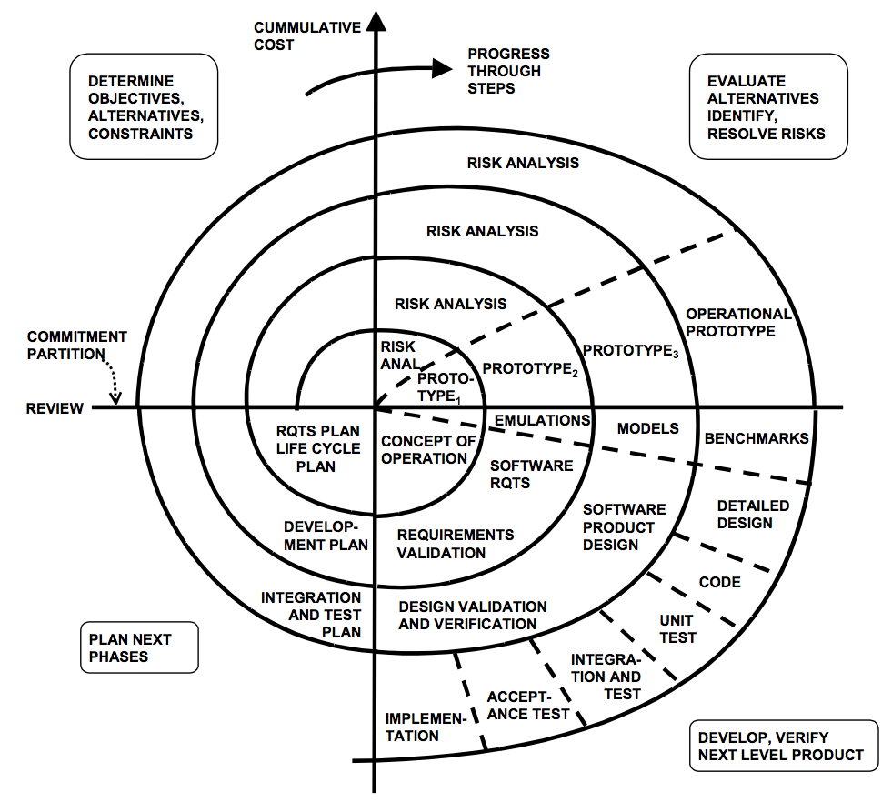
System/Software Development Life Cycle (SDLC) Boehm’s Spiral Model
Reference: http://csse.usc.edu/people/barry.html

Slide 36
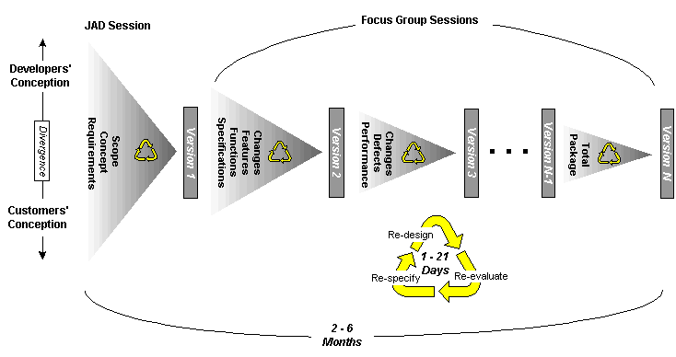
System/Software Development Life Cycle (SDLC) Rapid Application Development (RAD) Model
Iterative, but spiral cycles are much smaller.
Risk-based approach, but focus on “good enough” outcome.
SDLC fundamentals still apply…
Requirements, configuration, and quality management, design process, coding, test & integration, technical and project reviews etc.
Reference:
S. McConnel, Rapid Development: Taming Wild Software Schedules
http://www.cs.bgsu.edu/maner/domains/RAD.htm

Slide 37
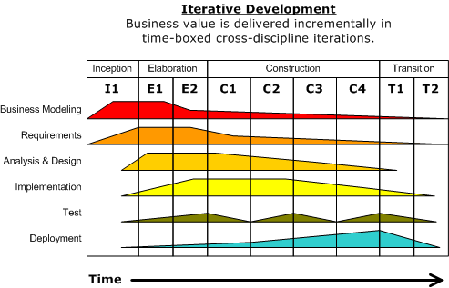
System/System Development Life Cycle (SDLC) Evolutionary Prototyping Model
The system concept is refined continuously…
The focus is on “good enough” concept, requirements, and prototype.
However, it is difficult to determine level of effort (LOE), cost, and schedule.
Reference: Rapid Development: Taming Wild Software Schedules, Steve McConnell, Microsoft Press, 1996

Slide 38
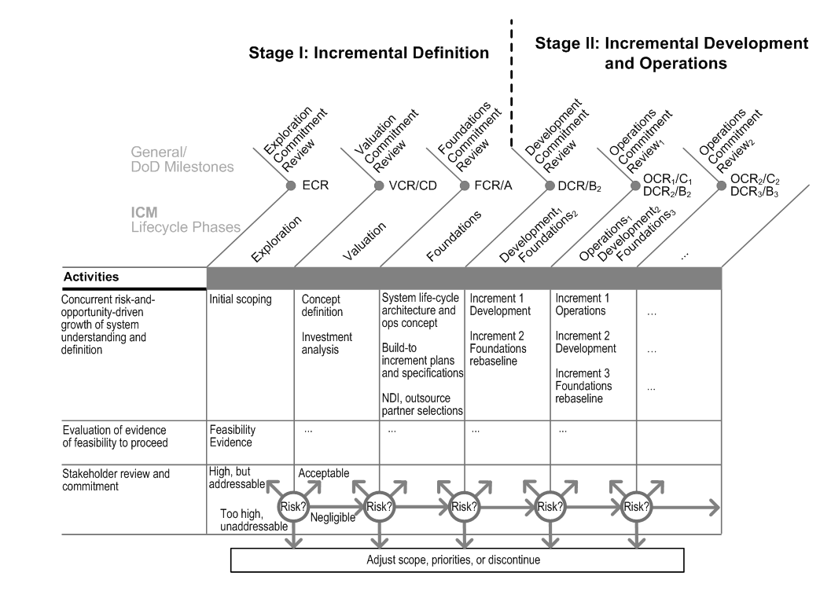
System/Software Development Life Cycle (SDLC) Incremental Commitment Model
Reference: B. Boehm, J.A. Lane, Using the Incremental Commitment Model to Integrate System Acquisition, Systems Engineering, and Software Engineering, CrossTalk, October 2007.

Slide 39
System/Software Development Life Cycle (SDLC) The need for speed... Agile Development Approach
Project Terms | Agile Terms
MNS | Vision
CONOPS | User Stories
SDP | Release & Iteration Plans, Backlogs
PMR/MS Reviews | Retrospectives, Product Demo

Slide 40
System/System Development Life Cycle (SDLC) Agile SDLC Model – Scrum
Scrum is an agile software development methodology and model that is both iterative and incremental.
The concept derived from the development of commercial products, where:
Product owner provides the vision and roadmap;
Scrum master specifies activities and ensures deliverables meet the sprint and iteration goals;
Team executes the specified scrum activities.
The process is executed in a series of “time-boxed” sprints and iterations, where:
A “sprint” is usually 2 to 4 weeks; and
The end-product is a “iteration”.
Reference:
T. Hirotaka, N. Ikujiro, The New Product Development Game, Harvard Business Review, January, 1986. (http://hbr.org/product/new-new-product-development-game/an/86116-PDF-ENG)
J. Sutherland, Agile Development: Lessons Learned from the First Scrum, 2004-10. (http://www.scrumalliance.org/resources/35)
R. Carlson, P.J. Matuzic, R.L. Simons, Applying Scrum to Stabilize Systems Engineering Execution, CrossTalk, May/June 2012.
Notes:
By the way “scrum” is a term in rugby means restarting of the game after a minor rugby rule infraction.

Slide 41
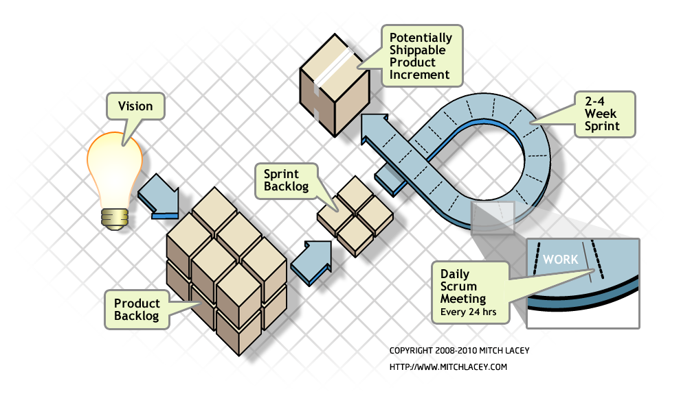
System/System Development Life Cycle (SDLC) Agile SDLC Model – Scrum
The product vision is translated into a list of project requirements;
This “list” is called the product backlog. It encompasses all the project requirements and work;
The scrum master works with the product owner to plan and divide the product backlog into a series of sprint backlog.
The self-organized team composed of domain and SMEs. The team is empowered to select, plan, and make decisions on its work task
The daily stand-up team meeting is called the daily-scrum. It keeps the team members focused on their tasks. Both product owner and scrum master are required to participate.
Reference:
R. Carlson, P.J. Matuzic, R.L. Simons, Applying Scrum to Stabilize Systems Engineering Execution, CrossTalk, May/June 2012.
Notes:
By the way “scrum” is a term in rugby means restarting of the game after a minor rugby rule infraction.

Slide 42
System/System Development Life Cycle (SDLC) Are there other SDLC models?
DevOps*
Idea observed from cloud computing...
2009, Flickr reported doing 10 deployments per day
Amazon EC2 reported in May 2011:**
Mean time between deployments: 11.6 seconds
Maximum # of deployments in an hour: 1,079
Mean # of hosts can simultaneously receive a deployment: 10k
Maximum # of hosts can simultaneously receive a deployment: 30k
http://youtu.be/o7-IuYS0iSE ***
Reference:
* J. Gorman, G. Kim, Security is Dead. Long Live Rugged DevOps: IT at Ludicrous Speed, RSA Conference 2012 (http://www.slideshare.net/realgenekim/security-is-dead-long-live-rugged-devops-it-at-ludicrous-speed)
** Jon Jenkins, Velocity Culture, O’Reilly Velocity 2011, (http://www.youtube.com/watch?v=dxk8b9rSKOo)
*** D. Edwards, The (Short) History of DevOps, Sept. 17, 2012. (http://youtu.be/o7-IuYS0iSE)

Slide 43
System/System Development Life Cycle (SDLC) Philosophy behind the Rugged DevOps
Seamless integration of software development and IT operations
Focus on the “big picture” rather than security controls
Standard configuration
Process discipline
Controlled access to production systems
Results
75% reduction in outages triggered by software deployment since 2006
90% reduction in outage minutes triggered by software deployments
Instantaneous automated rollback
Reduction in complexity
Back to our study...
Reference:
Jon Jenkins, Velocity Culture, O’Reilly Velocity 2011, (http://www.youtube.com/watch?v=dxk8b9rSKOo)

Slide 44
System/Software Development Life Cycle (SDLC) History of Systems/Software Engineering Process Standards

Slide 45
System/Software Development Life Cycle (SDLC) Software & System Engineering Management Processes
There are more and more “software-intensive” systems…
Systems are getting more complex. Hardware problems are often addressed through software;
Operating environments are stochastic. Software are more flexible than hardware.
As SDLC models evolves, management processes are evolving too…
DoD-STD-2167A: Waterfall SDLC + SE Process
MIL-STD-498: Modified Waterfall SDLC + SE Process
IEEE 1220: System Engineering Process
ISO 12207: Software + System Engineering Mgmt. Process
ISO 15288: System Engineering Mgmt. Process
Notes:
“Life cycles vary according to the nature, purpose, use and prevailing circumstances of the system. Each stage has a distinct purpose and contribution to the whole life cycle and is considered when planning and executing the system life cycle.” *
* Reference: ISO/IEC 15288:2008, Systems and Software Engineering – System Life Cycle Processes, February 2008.

Slide 46
System/Software Development Life Cycle (SDLC) DoD-STD-2167A – System Engineering Process
Reference: DoD-STD-2167A, Defense System Software Development, February 29, 1988

Slide 47
System/System Development Life Cycle (SDLC) Everything must be traceable
Verification: “The process of evaluating a system or component to determine whether the products of a given development phase satisfy the conditions imposed at the start of that phase.”
Validation: “Confirmation, through the provision of objective evidence, that the requirements for a specific intended use or application have been fulfilled.”
Reference: ISO/IEC/IEEE 24765:2010, Systems and Software Engineering - Vocabulary, 1st Ed. December 15, 2010.

Slide 48
System/Software Development Life Cycle (SDLC) ISO/IEC 15288:2008, System Life Cycle Processes
ISO/IEC 15288* encompasses:
Systems/software engineering processes (Technical Processes)
Project management processes
Project support infrastructure (Organizational Project-Enabling Processes)
Contract/business management processes (Agreement Processes)
* Note: ISO/IEC 15288 is identical to IEEE Std 15288

Slide 49
System/Software Development Life Cycle (SDLC) ISO/IEC 12207:2008, Software Life Cycle Processes
* Note: ISO/IEC 12207is identical to IEEE Std 12207
Reference: IEEE/IEC 12207:2008, Information Technology Software Life Cycle Processes

Slide 50
System/Software Development Life Cycle (SDLC) IEEE std 1220, System Engineering Process

Slide 51
System/Software Development Life Cycle (SDLC) IEEE std 1220: System Engineering Process (SEP)
IEEE 1220 defined System Engineering Process (SEP) within System Life Cycle (SLC)
Reference: IEEE STD 1220: Standard for Application and Management of the Systems Engineering Process

Slide 52
System/Software Development Life Cycle (SDLC) Introducing Security into SDLC

Slide 53
System/Software Development Life Cycle (SDLC) Security Considerations in SDLC
Initiation Phase (IEEE 1220: Concept Stage)
Survey & understand the policies, standards, and guidelines.
Identify information assets (tangible & intangible).
Define information classification & protection level (security categorization).
Define rules of behavior & security CONOPs.
Conduct preliminary risk assessment.
Acquisition / Development Phase (IEEE 1220: Development Stage)
Conduct risk assessment.
Define security requirements and select security controls (categories & types).
Perform cost/benefit analysis (CBA).
Security planning (based on risks & CBA).
Practice Information Systems Security Engineering (ISSE) Process to develop security controls.
Develop security test & evaluation (ST&E) plan for verification & validation of security controls.
Reference: NIST SP 800-64 Security Considerations in the Information System Development Life Cycle.

Slide 54
System/Software Development Life Cycle (SDLC) Security Considerations in SDLC
Implementation Phase (IEEE 1220: Production Stage)
Implement security controls in accordance with system security plan (SSP).
Perform Security Certification & Accreditation of target system.
Operations / Maintenance Phase (IEEE 1220: Support Stage)
Configuration management & perform change control.
Continuous monitoring – Perform periodic security assessment.
Disposition Phase (IEEE 1220: Disposal Stage)
Preserve information. archive and store electronic information
Sanitize media. Ensure the electronic data stored in the disposed media are deleted, erased, and over-written
Dispose hardware. Ensure all electronic data resident in hardware are deleted, erased, and over-written (i.e. EPROM, BIOS, etc.)
Reference: NIST SP 800-64 Security Considerations in the Information System Development Life Cycle.

Slide 55
System/Software Development Life Cycle (SDLC) Information Systems Security Engineering (ISSE) Process
Phase 1: Discover Information Protection Needs
Ascertain the system purpose.
Identify information asset needs protection.
Phase 2: Define System Security Requirements
Define requirements based on the protection needs.
Phase 3: Design System Security Architecture
Design system architecture to meet on security requirements.
Phase 4: Develop Detailed Security Design
Based on security architecture, design security functions and features for the system.
Phase 5: Implement System Security
Implement designed security functions and features into the system.
Phase 6: Assess Security Effectiveness
Assess effectiveness of ISSE activities.
Reference: Information Assurance Technical Framework (IATF) Rel. 3.1

Slide 56
System/Software Development Life Cycle (SDLC) Security starts at the beginning…
IEEE 1220 | DoD Acquisition SDLC | Key System Engineering Tasks | Key Security Engineering Tasks*
Concept Stage | User Needs & Technology Opportunities | Task 1: Discover Mission/Business Needs | Task 1: Discover Information Protection Needs
 |  | Understand customer’s mission/business goals (i.e., initial capability, project risk assessment) | Understand customer’s information protection needs (i.e., infosec. risk assessment)
 | Concept Refinement | Understand system concept of operations (CONOPS) | Understand operating environment (i.e., sensitivity of information assets, mode of operations)
 |  | Create high-level entity-data relations model (i.e., system context diagram) | Create information management model (IMM)
 |  | Define engineering project strategy and integrate into the overall project strategy | Define information protection policy (IPP) and integrate into the project strategy
 |  | Create system engineering management plan (SEMP) | Create system security plan (SSP) and integrate into SEMP
 | Milestone A | Task 6: Assess project performance in meeting mission/business needs
* Reference: Information Assurance Technical Framework (IATF), Release 3.1
Key Deliverables
Mission Needs Statement / Project Goal(s) and Objectives
System Capabilities
Preliminary CONOPS
Preliminary System Context Descriptions
Project Risk Assessment
Draft System Engineering Management Plan (SEMP)

Slide 57
IEEE 1220 | DoD Acquisition SDLC | Key System Engineering Tasks | Key Security Engineering Tasks
Development Stage | Technology Development | Task 2: Define System Requirements | Task 2: Define Security Requirements
 |  | Refine system context (e.g., functional components)
 |  | Define system requirements (e.g., functional, performance, operational, support, etc.) | Select assurance requirements and define security functional requirements
 |  | Refine CONOPS | Refine IMM and SSP
 |  | Baseline system requirements
 | Milestone B | Task 6: Assess project performance in meeting mission/business needs
 | System Development & Demonstration | Task 3: Design System Architecture | Task 3: Design System Security Architecture
 |  | Determine & select architecture framework
 |  | Design system architecture and allocate system requirements to subsystems and components (i.e., RTM) | Allocate system security requirements to subsystems and service components (i.e., RTM)
 |  | Analyze gaps (i.e., risk assessment)
 |  | Task 4: Develop Detailed System Design (Logical & Physical) | Task 4: Develop Detailed System Security Design (Logical & Physical)
 |  | Refine entity-data relations model (i.e., UML diagrams, data-flow, network, etc.) | Refine IMM, embed security controls into system design products (i.e., UML, data-flow, network, etc.)
 |  | Perform system synthesis analysis to assure system integration (i.e., system design, system architecture, system requirements, and project mission/business needs)
 | Milestone C | Task 6: Assess project performance in meeting mission/business needs
Key Deliverables
System Requirements
Functional Definitions (+ allocation of system requirements)
System Architecture (Contextual + Logical)
Detailed System Design (Logical + Physical)
Requirements Traceability Matrix (RTM)

Slide 58
IEEE 1220 | DoD Acquisition SDLC | Key System Engineering Tasks | Key Security Engineering Tasks
Production Stage | Production and Deployment | Task 5: Implement System Design | Task 5: Implement Security Controls
 |  | Procure system components / construct system
 |  | Code/ customize/ configure system functional components
 |  | Conduct code inspection/ walk-through/ unit test
 |  | Perform system integration
 |  | Conduct system test | Conduct security test & evaluation (ST&E)
 |  | Task 6: Assess project performance in meeting mission/business needs
 |  | Generate system operations procedure (SOP) and users guide/ manual | Generate SOP (a.k.a. trusted facility manual (TFM)), Incident response plan, business continuity plan (BCP)
 |  | Conduct system readiness review | Obtain system certification
 |  | Deploy system
 |  | Conduct system acceptance test | Assess security effectiveness
 |  | Obtain approval to operate (ATO)
Key Deliverables
Implement detailed system design
Perform test & evaluations (unit, system, security tests)
Test reports
Standard Operating Procedure (SOP) + User Manuals
Deploy system
Conduct acceptance tests

Slide 59
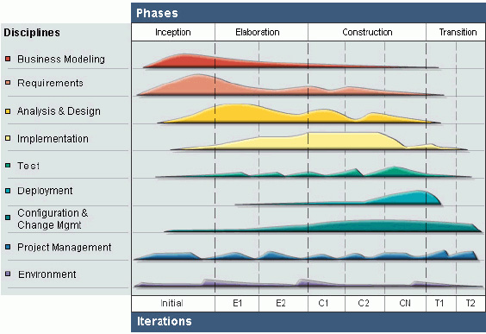
System/Software Development Life Cycle (SDLC) Rational Unified Process (RUP)
Reference: http://www.ibm.com/developerworks/webservices/library/ws-soa-term2/

Slide 60
System/Software Development Life Cycle (SDLC) Rational Unified Process (RUP)
Use cases drives requirements (Business Needs/Concept Exploration)
System, software, and security engineers create operational use cases (e.g., operational, functions, threat, risks models)
Use cases drives operational requirements
System design drives design specifications (Concept Definition/Detailed Design)
Operational requirements are decomposed into system functions and functional requirements
Architecture organizes system functions allocation of functional requirements
Architecture is further decomposed into detailed system design
Detailed system design is explained in design specifications
Design specifications drives programming of software codes (Implementation/Coding/Integration/Testing)
Software components integrated into functional components/subsystems (Unit Testing)
Functional subsystems integrated into system (/systems) (System Testing)
System perform functions that meets the operational needs (Acceptance Testing)
Deployment/transition into operations

Slide 61
System/Software Development Life Cycle (SDLC) Integrated System/Security Engineering in RAD

Slide 62
Questions:
What are the relationships between SDLC models and SSE-CMM models?
SDLC describes… to a system acquisition project
SSE-CMM describes…
What are the relationships between security controls models (NIST SP800-53, DoDI 8500.2, ISO/IEC 27001, etc.) and CMM/SSE-CMM models?
Security assurance requirements provide measurement of…
CMM utilizes the measurement metrics from security control models to measure…

Slide 63
Answers:
What are the relationships between SDLC models and SSE-CMM models?
SDLC describes the key engineering process to a system acquisition project
SSE-CMM describes the key security and management processes to a security engineering practice
What are the relationships between security controls models (NIST SP800-53, DoDI 8500.2, ISO/IEC 27001, etc.) and CMM/SSE-CMM models?
Security assurance requirements provide measurements of management, operational, and technical controls
CMM utilizes the measurement metrics from security control models to measure practice maturity

Slide 64
Topics Software Development Security Domain
Governance & Management
System Life Cycle and Security
Software Environment and Security Controls
Programming Languages
Database and DB Warehousing Vulnerabilities, Threats, and Protections
Software Vulnerabilities and Threats

Slide 65
Software Environment and Security Controls Review of Computer Operations Architecture Model
Reference monitor is a conceptual abstraction of a “machine”, system, or software that mediates access of objects by subjects.
Trusted computing base is a system of security controls that meets the confidentiality and integrity security objectives.
Secure kernel is a part of the trusted computing base that implements reference monitor concept.
Reference: Secrets & Lies – Digital Security in a Networked World, Bruce Schneier, Wiley Publishing, 2000

Slide 66
Software Environment and Security Controls Reference Monitor
Reference monitor is performed by a reference validation mechanism.
Reference validation mechanism is a system composed of hardware and software.
Operating condition principles:
The reference validation mechanism must be tamper proof.
The reference validation mechanism must always be invoked.
The reference validation mechanism must be small enough to be subject to analysis and tests to assure that it is correct.
OS shall be evaluated at TCSEC B2 (i.e. structured protection) and above.

Slide 67
Software Environment and Security Controls Trusted Computing Base (TCB)
The Trusted Computing Base is the totality of protection mechanisms within a computing system – hardware, firmware, software, processes, transports
The TCB maintains the confidentiality and integrity of each domain and monitors four basic functions:
Process activation
Execution domain switching
Memory protection
Input/output operation
Reference: DoD 5200.28-STD, Department of Defense Trusted Computer System Evaluation Criteria (TCSEC), August 15, 1983

Slide 68
Software Environment and Security Controls Secure Kernel
Secure kernel is an implementation of a reference monitoring mechanism responsible for enforcing security policy.
It meets the following three (3) conditions:
Completeness. All accesses to information must go through the kernel.
Isolation. The kernel itself must be protected from any type of unauthorized access.
Verifiability. The kernel must be proven to meet design specifications.

Slide 69
Software Environment and Security Controls Processor Privilege States
Processor privilege states protect the processor and the activities that it performs.
Privileged levels are called rings.
For example: Intel x86 has 4 privilege ring levels
Ring 0 contains kernel functions of the OS.
Ring 1 contains the OS.
Ring 2 contains the OS utilities.
Ring 3 contains the applications.

Slide 70
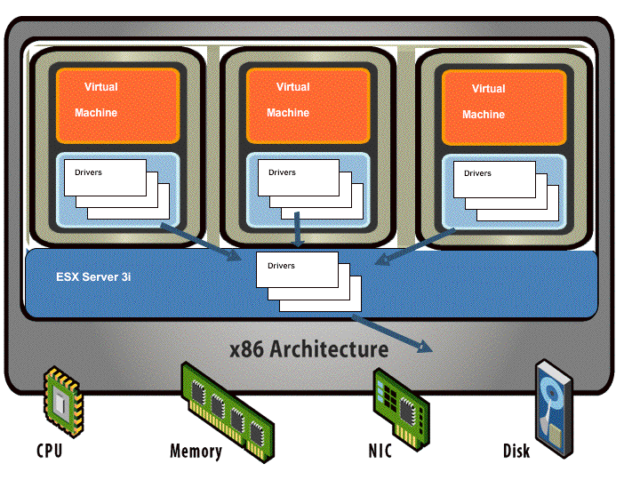
Software Environment and Security Controls Example of Processor Privilege States
VMware ESX
Hypervisor operates at Ring 0
Guest OS kernel and OS now moved to Ring 1
OS utilities in Ring 2
Application in Ring 3
Reference: VMware ESX I/O Driver Model (http://blogs.vmware.com/performance/2007/11/ten-reasons-why.html)

Slide 71
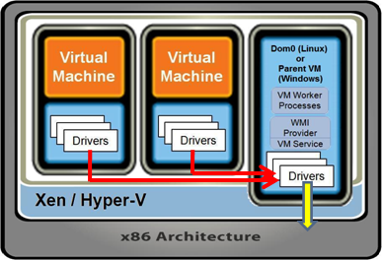
Software Environment and Security Controls Same principles, but different technology thus different attacks
Reference monitoring principles is consistent even with virtualization: Violation of privilege
Hypervisor vulnerabilities. Attack of kernel (Ring 0)
Hypervisor escape vulnerabilities. Violation of isolation of guest VMs (Ring 0)
Administrative VM vulnerabilities
Management server vulnerabilities. Exploitation of virtualized system configuration. (Ring 0)
Management console vulnerabilities. Attacks of privileged state (Entire TCB)
Guest VM vulnerabilities. Exploitation of OS vulnerabilities, but can potentially provide an attack vector to administrative VM, hypervisor, then other guest VMs (Ring 3/Ring 2 → Ring 1 → Ring 0)
Reference: Virtual Reality (http://blogs.vmware.com/virtualreality/2008/06/)

Slide 72
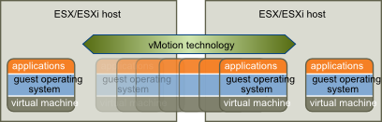
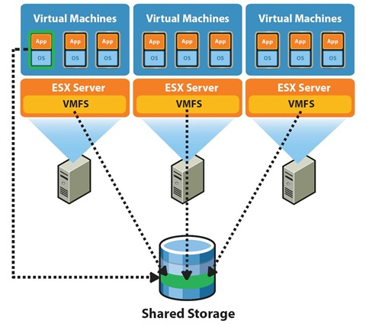
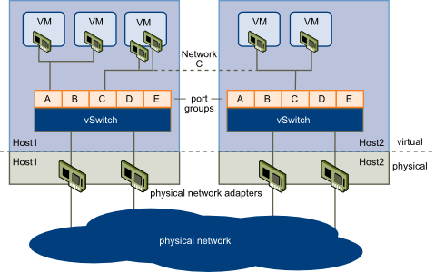
Software Environment and Security Controls Example of Processor Privilege States – Many-to-Many
VMware vSphere further abstracts the hardware layer
Virtual Machine File System (VMFS) for abstraction of data storage
vNetwork Distributed Switch (vDS) for abstraction of network layer
vMotion for distribution of processing power and high availability
Reference: http://pubs.vmware.com/vsphere-4-esx-vcenter/index.jsp?topic=/com.vmware.vsphere.intro.doc_41/c_vmware_infrastructure_introduction.html

Slide 73
Software Environment and Security Controls More complexity, more attack surfaces - Examples
Hypervisor vulnerability:
CVE-2010-2070: Xen IA-64 architecture, allows local user to modify processor status register that can cause DoS. (CVSS: 4.9 [Medium])
Hypervisor escape vulnerability:
CVE-2009-1244: VM display function in VMware allows guest OS user to execute arbitrary code in hypervisor. (CVSS: 6.8 [Medium])
Administrative VM vulnerabilities:
CVE-2008-2097: Buffer overflow in VMware ESX management service that allows remote authenticated users to gain root privileges. (CVSS: 9.0 [High])
CVE-2008-4281: Directory traversal in VMware ESXi that allows VM administrators to gain elevated privileges. (CVSS: 9.3 [High])
CVE-2009-2277: Cross-site scripting (XSS) vulnerability in WebAccess in VMware VirtualCenter that allows remote attacker to inject arbitrary web script to steal “context data” such as authentication credentials (CVSS: 4.3 [Medium])
Guest VM vulnerabilities:
CVE-2011-2145: VMware Host Guest File System (HGFS) allows Solaris or FreeBSD guest OS users to modify guest OS files. (CVSS: 6.3 [Medium])
CVE-2011-2217: ActiveX controls in Internet Explorer allows remote attacker to execute arbitrary code or corrupt memory in VMware Infrastructure. (CVSS: 9.3 [High])
Reference:
T. McNevin, Introduction to Hypervisor Vulnerabilities (Part 1), MITRE, 2009
B. Williams, T. Cross, Virtualization System Vulnerabilities, IBM X-Force, 2010
NVD (http://web.nvd.nist.gov/view/vuln/search)

Slide 74
Software Environment and Security Controls Security Controls for Software Environment
For CISSP Exam, countermeasures are also called “security controls”…
Security Controls for Buffer Overflows
Memory Protection
Covert Channel Controls
Cryptography
Password Protection Techniques
Inadequate Granularity of Controls
Control and Separation of Environments
Time of Check/Time of Use (TOC/TOU)
Social Engineering
Backup Controls
Malicious Code/Malware Controls
Virus Protection Controls
Mobile Code Controls
Sandbox
Programming Language Support
Access Controls
Reference: Official (ISC)² Guide to The CISSP CBK, H. Tipton, et. al., (ISC)² Press, Auerbach Publications, 2007.

Slide 75
Software Environment and Security Controls Security Controls for Buffer Overflow
One of the oldest and most common problems to software.
A buffer overflow occurs when a program or process tries to store more data in a buffer (temporary data storage area) than it was intended to hold.
Vulnerability is caused by lack of parameter checking or enforcement for accuracy and consistency by the software application or OS.
Countermeasure:
Practice good SDLC process (code inspection & walkthrough).
Programmer implementing parameter checks and enforce data rules.
Apply patches for OS & applications.
If available, implement hardware states and controls for memory protection.
Buffer management for OS.

Slide 76
Software Environment and Security Controls Memory Protection
Memory protection is enforcement of access control and privilege level to prevent unauthorized access to OS memory.
Countermeasures:
Ensure all system-wide data structures and memory pools used by kernel-mode system components can only be accessed while in kernel mode.
Separate software processes, protect private address space from other processes.
Hardware-controlled memory protection
Use Access Control List (ACL) to protect shared memory objects.

Slide 77
Software Environment and Security Controls Covert Channel Controls*
Covert channel is an un-controlled information flow (or unauthorized information transfer) through hidden communication path(s).
Storage channel
Timing channel
Countermeasure steps:
Identify potential covert channel(s)
Verify and validate existence of covert channel(s)
Close the covert channel by install patch or packet-filtering security mechanism.
* Note: While the definition of covert channel may be old, it is considered as “fundamental” in CISSP CBK.
Reference: NCSC-TG-30, A Guide To Understanding Covert Channel Analysis of Trusted System

Slide 78
Software Environment and Security Controls Covert Channel Controls*
Countermeasure for covert channel:
Information Flow Model is a variation of access control matrix
Information Flow Model is based on Object Security Levels.
Object-to-object information flow is constrained in accordance with object’s security attributes.
Object | A | B | C | D | E | F | G
A | N/A |  |  | X
B |  | N/A |  |  |  | X
C | X |  | N/A
D |  |  |  | N/A | X
E |  | X |  |  | N/A
F |  |  |  |  |  | N/A | X
G |  |  | X |  |  |  | N/A
Notes:
In a systematic scale, we use the information flow model to describe information flow between objects. Similar to the access control matrix, the information flow model is often used in conjunction with other security models. For example, the labeled mandatory access control using the Bell-LaPadula Confidentiality Model. So, Data Object A is at the same label security level as Data Object C, and B to E, C to G, etc.

Slide 79
Software Environment and Security Controls Cryptography
Cryptography provides confidentiality, integrity, authentication, and non-repudiation in information operations.
Asymmetric Key Cryptography
Because of slow cipher operation speed, it is mostly used for key management function.
Symmetric Key Cryptography
Because of speed, symmetric-key cryptosystems are used for crypto. operations. E.g. SSL/TLS at Transport-level (communication path), e-mail & SOAP messages at message-level.
Hash Function
Message Digest
Message Authentication Code (MAC)
Key-hashed MAC (HMAC)
Digital Signature

Slide 80
Software Environment and Security Controls Security Controls: Password Protection Techniques
Password Structure
Password length
Password complexity: a mix of upper/lowercase letters, numbers, special characters
Not using common words found in dictionary
Password Maintenance
Set password lifetime limits & policy…
Password change in <90> days
Password can not be reused within <10> password changes
<One> change to <every 24 hr.>
Password file must be encrypted and access controlled.

Slide 81
Software Environment and Security Controls Granularity of Controls
Separation of duties means that a process is designed so that separate steps must be performed by different people (i.e. force collusion)
Define elements of a process or work function.
Divide elements among different functions
Least privilege is a policy that limits both the system’s user and processes to access only those resources necessary to perform assigned functions.
Limit users and system processes to access only resources necessary to perform assigned functions.
Separation of system environments.
Development environment.
QA/test environment.
Production or operational environment.

Slide 82
Software Environment and Security Controls Other Security Controls
Social Engineering
Countermeasure: User security awareness training.
Backup, Malicious Code/Malware, Virus Protection Controls
Countermeasures:
Install & use anti-virus system, H-IDS.
Enable access control to critical system files.
Tape backups, access control of media.
Encrypt sensitive information for confidentiality & integrity.
Mobile Code Controls
Install Sandbox for access control of mobile codes.
Example: Java “containers” or Java Virtual Machine (JVM).
Java applets running in Web browser.
Applications using Java Remote Method Invocation (RMI) to run Java Beans.

Slide 83
Software Environment and Security Controls Security Controls – Access Controls
Discretionary access control (DAC)
Information owner determines who has access & what privileges they have.
Mandatory access control (MAC)
Information classification & system determine access.
Access decision based on privilege (clearance) of subject & sensitivity (classification) of object (file).
Requires labeling (or data tag)
Access Control/Capability Matrix
Implement through the use of ACL.
View-based Access Control
Authorization of specific views by tables, columns, and key sets.

Slide 84
Questions:
What are the three operating condition principles for a reference monitor?
What are the three operating conditions for a secure kernel?

Slide 85
Answers:
What are the three operating condition principles for a reference monitor?
must be tamper proof
must always be invoked
subject to analysis and tests
What are the three operating conditions for a secure kernel?
Completeness (must always be invoked)
Isolation (must be tamper proof)
Verifiability (each operations shall be subject to analysis and tests)

Slide 86
Questions:
What causes buffer overflow?
Why a good information flow model is a good tool for supporting the identification of covert channel?

Slide 87
Answers:
What causes buffer overflow?
When a program or process that lacks parameter enforcement control tries to store more data in a buffer than it was intended to hold
Why a good information flow model is a good tool for supporting the identification of covert channel?
Information flow model is the system design baseline that illustrates the directional vectors of information flow between objects (e.g., programs or processes)

Slide 88
Questions:
Program that allows the information owner to determine who has what type of access and privilege is an implementation of what type of access control?
For mandatory access control (MAC), an access decision is based on privilege of ___ & sensitivity of ___?

Slide 89
Answers:
Program that allows the information owner to determine who has what type of access and privilege is an implementation of what type of access control?
Discretionary access control (DAC)
For mandatory access control (MAC), an access decision is based on privilege of ___ & sensitivity of ___?
Subject
Object

Slide 90
Topics Software Development Security Domain
Governance & Management
System Life Cycle and Security
Software Environment and Security Controls
Programming Languages
Database and DB Warehousing Vulnerabilities, Threats, and Protections
Software Vulnerabilities and Threats

Slide 91
Programming Languages
A set of instructions and rules that tell the computer what operations to perform.
Languages have evolved in “generations”
1st Generation: Machine language
2nd Generation: Assembly language
3rd Generation: High-level language
Ada, COBOL, BASIC, FORTRAN, Pascal, C, C+, C++, C#, Java
4th Generation: Very high-level language
SQL, JavaScript, Perl, SGML (Standard General Markup Language): HTML, XML, SAML, XACML.
5th Generation: Natural language
BPEL (Business Process Execution Language), BQEL (Business Query Language)

Slide 92
Programming Languages
Assembler – program that translates an assembly language program into machine language.
Assembly Language → Machine Language.
Compiler – translates a high-level language into machine language.
High-level Language (3rd Gen.) → Machine Language.
Interpreter – instead of compiling a program at once, the interpreter translates it instruction-by-instruction. It has a fetch and execute cycle.
Very high-level Language (4th Gen.) → Interpreter instruction → Machine Language.

Slide 93
Programming Languages Object-Oriented Programming (OOP)
OOP method that creates an object.
The object is a block of pre-assembled code that is a self-contained module.
Once written, object can be reused.
Objects are encapsulated, thus providing some security.
Objects have methods (code with programming interfaces) and attributes (data) encapsulated together.

Slide 94
Programming Languages Object-Oriented Programming (OOP) – Characteristics
Object is an instance of the class.
Class tell the system how to make objects.
Encapsulation is the technique of keeping together data structures and methods (procedures) which act on them.
Method is a procedure or routine associated with one or more classes.
Message: objects perform work by sending messages to other objects.
Inheritance is the ability to derive new classes from existing classes. A derived class (or subclass) inherits the instance variables and methods of the “base-class” (or superclass), and may add new instance variables and methods.

Slide 95
Programming Languages Object-Oriented Programming (OOP) – Characteristics
Polymorphism describes the process of using an object in different ways for different set of inputs.
Polyinstantiation is creating a new version of an object by replacing variables with other values (or variables).
Also used to prevent inference attacks against databases because it allows different versions of the same information to exist at different classification levels.
Cohesion is the ability of a module to execute one function with little interaction from other modules.
Coupling is a measure of the interconnection among modules in an application.

Slide 96
Programming Languages Distributed Object-Oriented Systems
Common Object Request Broker Architecture (CORBA)
A standard that “wrap” data objects. The object request broker (ORB) component enables heterogeneous applications and computing environment to interoperate.
Component Object Model (COM) & Distributed Component Object Model (DCOM)
COM and DCOM are Microsoft object-oriented system standards for interoperate in a heterogeneous applications within a homogeneous (Microsoft) computing environment. It uses Object Linking & Embedding (OLE) and ActiveX.
Java
Java Platform Standard Edition (Java SE)
Java Platform Enterprise Edition (Java EE)

Slide 97
Programming Languages Common Object Request Broker Architecture (CORBA)
A set of standards that address the need for interoperability between hardware and software.
Allows applications to communicate with one another regardless of their location.
The Object Request Broker (ORB) establishes a client/server relationship between objects.
The ORB enforces the system’s security policy.
Notes:
Page 989

Slide 98
Programming Languages How CORBA Works
CORBA uses Interface Definition Language (IDL) to describe interface requirements.
CORBA uses Internet Inter-ORB Protocol (IIOP) to communicate between Object Request Brokers (ORBs).
Source: http://www.omg.org/gettingstarted/corbafaq.htm

Slide 99
Programming Languages Component Object Models
Component Object Model (COM) architecture
An open software architecture from DEC and Microsoft, allowing interoperation between ObjectBroker and OLE. Microsoft evolved COM into DCOM .
Distributed Component Object Model (DCOM) architecture
An extension of COM to support objects distributed across a network.
Notes:
Page 991

Slide 100
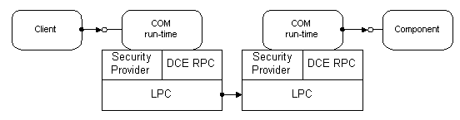
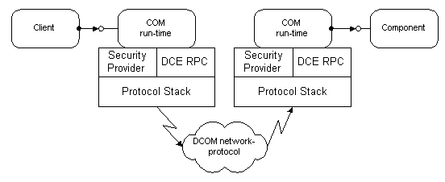
Programming Languages Component Object Models
Source: http://technet.microsoft.com/en-us/library/cc722925.aspx
Notes:
RPC = Remote Procedure Call
LPC = Local Procedure Call

Slide 101
Programming Languages Object Linking & Embedding (OLE)
OLE allows applications to share functionality by live data exchange and embedded data.
Embedding – places data in a foreign program.
For example: Embedding of a Visio diagram inside of a PowerPoint slide.
Linking – capability to call a program.
For example: Double click on the embedded Visio diagram in a PowerPoint slide and invoke Visio application to edit the diagram.

Slide 102
Programming Languages ActiveX
A loosely defined set of technologies developed by Microsoft. ActiveX is a set of technologies that enables interactive contents for web.
Elements of ActiveX technologies:
ActiveX Controls: interactive objects in a web page that provides user interaction functions.
ActiveX Documents: enable user to view non-HTML documents (e.g. Word, Excel, or PPT)
ActiveX Scripting Controls: integrated controls for ActiveX controls and/or Java Applets from web browser or server.
Java Virtual Machine (JVM): enables web browser (IE) to run Java applets and integrate with ActiveX controls.
ActiveX Server Framework: provide web server functions to support the above functions plus objects for database access and online transactions.
Notes:
Page 1015

Slide 103
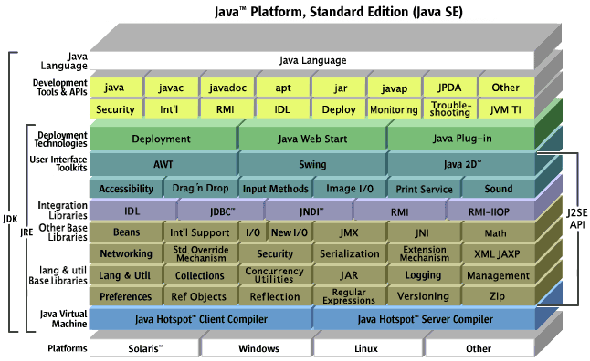
Programming Languages Java Platforms
Source: http://java.sun.com/javase/javasemap-lg.html
Java is designed as a standard application “platform” for computing in a networked heterogeneous environment (developed by Sun Microsystems.)
Java is a high-level programming language. Java source code are compiled into bytecode, which can then be executed by a Java interpreter.
Java has three platforms:
Java SE (Standard Edition)
Java EE (Enterprise Edition)
Java ME (Micro Edition)
Notes:
Page 1013

Slide 104
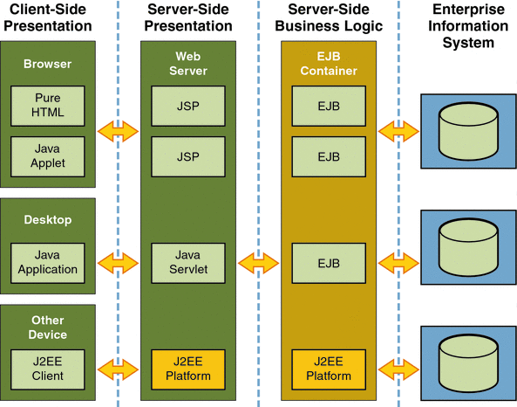
Programming Languages Java Platform Enterprise Edition
Java Enterprise Edition (Java EE) uses Java SE as a foundation
There are Containers are the runtime components for Java EE.
Applet
Application Client
Web
EJB
Source: http://docs.oracle.com/cd/E19879-01/820-4343/abeat/index.html

Slide 105
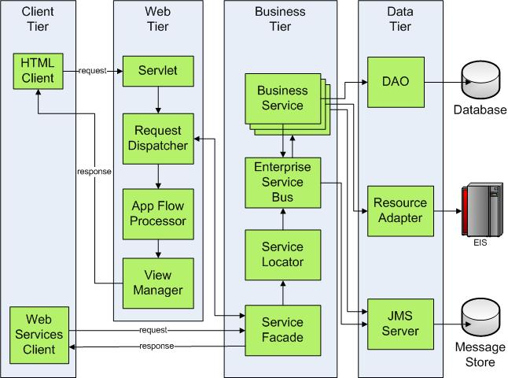
Programming Languages Java Application Server Architecture
Source: http://www.javaworld.com/javaworld/jw-01-2008/images/tomcat6_1.jpg

Slide 106
Questions:
COBOL, FORTRAN, C, C+, C++, C# are what generation programming languages?
JavaScript, Perl, SQL, SGML are what generation programming languages?
What mechanism translates a high-level language (3rd Generation) into machine language?

Slide 107
Answers:
COBOL, FORTRAN, C, C+, C++, C# are what generation programming languages?
3rd Generation
JavaScript, Perl, SQL, SGML are what generation programming languages?
4th Generation
What mechanism translates a high-level language (3rd Generation) into machine language?
Compiler

Slide 108
Questions:
In object-oriented programming (OOP), what tells the system how to make object(s)?
In OOP, what is the technique that keeps the data structures and methods (procedures) together?
In OOP, what is the term that describes the process of using an object in different ways for different set of inputs?

Slide 109
Questions:
In object-oriented programming (OOP), what tells the system how to make object(s)?
Class
In OOP, what is the technique that keeps the data structures and methods (procedures) together?
Encapsulation
In OOP, what is the term that describes the process of using an object in different ways for different set of inputs?
Polymorphism

Slide 110
Topics Software Development Security Domain
Governance & Management
System Life Cycle and Security
Software Environment and Security Controls
Programming Languages
Database and DB Warehousing Vulnerabilities, Threats, and Protections
Software Vulnerabilities and Threats

Slide 111
Database and DB Warehousing Vulnerabilities, Threats, and Protections Database Management System (DBMS)
Databases are developed to manage information from many sources in one location.
Eliminate the need for duplication of information in the system (thus preserves storage space).
Prevent inconsistency in data by making changes in one central location.
DBMS consists of: hardware, software, and databases used to manage large sets of structured data (or information asset).
Enables Multiple Users and Applications to access, view, and modify data as Needed.
Can enforce control restrictions.
Provides data integrity and redundancy.
Established procedures for data manipulation.

Slide 112
Database and DB Warehousing Vulnerabilities, Threats, and Protections DBMS Models
Hierarchical DBMS
Stores information records (data) in a single table
Uses parent/child relationships
Limited to a single tree, no links between branches
Network DBMS
Relationship of information records are of same type
All associations are direct connects, which forms a network
Relational DBMS
Information records are structured in tables
Columns are the “attributes”, Rows are the “records”
Object-oriented DBMS & object relational DBMS
Information records are objects
Relationships of objects are dynamic. The association can be made hierarchical, network, or relational

Slide 113
Database and DB Warehousing Vulnerabilities, Threats, and Protections Relational DBMS (RDBMS)
Information records (data) are structured in database tables.
Columns (attributes) represent the variables
Rows (records) contain the specific instance of information records
Atomic relation = Every row/column position has always exactly one data value and never a set of values.
Attributes
Traveler Manifest Table
Unique ID | Last Name | First Name | Port of Entry (POE)
123456-123456 | Smith | John | DCA
234567-123456 | Rogers | Mike | LGA
345678-123456 | Johnson | John | SFO
456789-123456 | Smith | Jack | SAN
Tuples /
Rows

Slide 114
Database and DB Warehousing Vulnerabilities, Threats, and Protections Relational DBMS (RDBMS) – Primary & Foreign Keys
Data within the RDBMS…
Unique ID is the “primary key”. It identifies each row (record or tuple)
Tuple cannot have a null value in the primary key.
The primary key value guarantees that the tuple is unique
“Foreign key” is an attribute or combination of attributes in another database table that matches the value of “primary key” in the first database table
Referential integrity rule
For any foreign key value, the reference relation to another table must have a tuple with the same value of the other table’s primary key
A null value in the foreign key field prevents a join

Slide 115
Database and DB Warehousing Vulnerabilities, Threats, and Protections Relational DBMS (RDBMS) – Primary & Foreign Keys
Traveler Manifest Table
Unique ID | Last Name | First Name | Port of Entry (POE)
123456-123456 | Smith | John | DCA
234567-123456 | Rogers | Mike | LGA
345678-123456 | Johnson | John | SFO
456789-123456 | Smith | Jack | SAN
Primary Key
Foreign Key
Baggage Manifest Table
Unique Tag ID | Airline | Flight Number | Unique ID
DCA456-123456 | AA | AA-456 | 123456-123456
LGA567-123456 | JetBlue | JB-567 | 234567-123456
SFO678-123456 | United | UA-678 | 345678-123456
SAN89-123456 | NW | NW-89 | 456789-123456

Slide 116
Database and DB Warehousing Vulnerabilities, Threats, and Protections Relational DBMS (RDBMS) – View & Schema
Data dictionary – Central repository of data elements and their relationships.
Schema – Holds data that describes a database.
View – Virtual relation defined by the database to keep subjects from viewing certain data.

Slide 117
Database and DB Warehousing Vulnerabilities, Threats, and Protections Relational DBMS (RDBMS) – Security Issues
Ensure integrity of input data (check input values, prevent buffer overflow).
Access control ensuring only authorized user are performing authorized activities (“need-to-know”, “least privilege”).
Preventing deadlock (stalemate when 2 or more processes are each waiting for the other to do something before they can proceed).

Slide 118
Database and DB Warehousing Vulnerabilities, Threats, and Protections OODBMS &ORDBMS
Class is a set of objects which shares a common structure and behavior. The relationship between classes can be hierarchical. (i.e. super-class, and subclass.)
Object is a unique instance of a data structure defined according to the template provided by its class. Each object has its own values for the variables belonging to its class and can respond to the messages (methods) defined by its class.
Method is a procedure or routine associated with one or more classes.

Slide 119
Database and DB Warehousing Vulnerabilities, Threats, and Protections OODBMS &ORDBMS
Object-oriented database (OODB) represents a “paradigm-shift” in the traditional database models (hierarchical, network, and relational).
Example of OODBMS: Versant.
Object relations are build dynamically based on “business needs” instead of a series of fixed “business processes”.
Currently, the foundational DBMS engine for most of ORDBMS are still RDBMS. Object relations are build:
Presentation Layer: User/client level.
Business Logic Layer: Accepts commands from the presentation layer and send instructions to the data layer.
Data Layer: The database.
Example of ORDBMS: Oracle (8i, 9i, 10g), IBM DB2.

Slide 120
Database and DB Warehousing Vulnerabilities, Threats, and Protections Data Warehousing and Mining
Data Warehousing
Combines data from multiple databases or data sources into a large database called “data warehouse”.
Requires more stringent security because all data is in a central facility.
Data Mining
A.k.a. Knowledge-discovery in databases (KDD).
Practice of automatically searching large stores of data for patterns.
Data mining tools are used to find associations and correlations to product Metadata and can show previously unseen relationships.

Slide 121
Database and DB Warehousing Vulnerabilities, Threats, and Protections Database Controls
Granularity - The degree to which access to objects can be restricted.
Content dependant access control
Permissions by View combining specific tables, columns, and key sets.
Authorizations for specific views having specific attributes, and for actions to perform within those views.
DAC, by specific grant to user or group by owner.
MAC, by classification level.
Cell Suppression
A technique used to hide or not show specific cells that contain information that could be used in an inference attack.

Slide 122
Database and DB Warehousing Vulnerabilities, Threats, and Protections Database Controls
Partitioning – Involved dividing a database into different parts which makes it harder for an individual to find connecting pieces
Noise and perturbation – A technique of inserting bogus information aimed at misdirecting or confusing an attacker
Concurrency – allowing multiple users to access the data contained within a database at the same time.
Making sure the most up to date information is available
If concurrent access is not managed by the Database Management System (DBMS) so that simultaneous operations don't interfere with one another problems can occur when various transactions interleave, resulting in an inconsistent database.

Slide 123
Database and DB Warehousing Vulnerabilities, Threats, and Protections Database Controls – Types of Integrity Service
Semantic integrity – Ensures that structural and semantic rules are enforced. Types of rules include data types, logical values, uniqueness constraints, and operations that could adversely affect the database.
Entity integrity – Ensures that tuples are uniquely identified by primary key values.
Referential integrity – Ensures that all foreign keys reference valid (and existing) primary keys. The other word, if a record does not include a primary key it cannot be referenced.

Slide 124
Database and DB Warehousing Vulnerabilities, Threats, and Protections Database Controls – Configurable Controls for Integrity
Rollback – is a statement that ends a current transaction and cancels all other changes
Occurs when some type of “glitch” is encountered during transaction
Commit – terminates a transaction and executes all changes that were just made by a user.
If a user attempts a “commit” and it cannot be completed correctly…a “rollback” is executed to ensure integrity
Savepoint(s) – are used to ensure that if a system failure occurs, or an error is detected, the database can return to a known good state prior to the problem
Checkpoint(s) – (similar to Savepoints) when the database S/W fills to a certain amount of memory, a checkpoint is initiated, which saves the data from the memory segment to a temporary file.

Slide 125
Database and DB Warehousing Vulnerabilities, Threats, and Protections Database Security Controls
Polyinstantiation
Allows a relation to contain multiple rows with the same primary key
The multiple instances of Primary Keys are distinguished by their security levels
Used to prevent inference attacks by inserting “bogus” data at lower security levels
Granularity – The degree to which access to objects can be restricted.
Granularity can be applied to both the actions allowable on objects, as well as to the users allowed to perform those actions on the object

Slide 126
Database and DB Warehousing Vulnerabilities, Threats, and Protections Database Security Issues
Online Transaction Processing (OLTP)
Usually used when multiple databases are clustered to provide fault tolerance and higher performance.
Transaction logs are used for synchronization of databases
OLTP transactions occur in real time which usually updates more than one database…which introduces integrity threats. To counteract this ACID test should be implemented.
Atomicity – Divides transactions into units of work and ensures all modifications take effect or none do
Consistency – A transaction must follow integrity policy for that specific database and ensure that all data is consistent in the different databases
Isolation – Transactions execute in isolation until completed, without interacting with other transactions
Durability – Once the transaction is verified as accurate on all systems, it is committed and the databases cannot be rolled back

Slide 127
Database and DB Warehousing Vulnerabilities, Threats, and Protections Database Threats
Aggregation
The act of combining information from separate sources.
The combined information has a sensitivity level greater that any of the individual parts.
Inference
A user deduces (infers or figures out) the full story from pieces learned through aggregation and other sources.
Differs from aggregation in that data not explicitly available is used during the act of deduction (inference or plain figuring it out).
Deadlocking
Two processes have locks on separate objects and each process is trying to acquire a lock on the object the other process has.

Slide 128
Questions:
What are the four types of database management system (DBMS) models?
In RDBMS, what is the definition for atomic relation?
In RDBMS, what is a primary key?

Slide 129
Answers:
What are the four types of database management system (DBMS) models?
Hierarchical
Network
Relational
Object-oriented
In RDBMS, what is the definition for atomic relation?
Every row/column position always contains exactly one data value
In RDBMS, what is a primary key?
The attribute that uniquely identifies each record

Slide 130
Questions:
For RDBMS, how is the relationship between database tables created?
In an object-oriented relational database (ORDBMS), what are the three layers where the object relations are build?

Slide 131
Answers:
For RDBMS, how is the relationship between database tables created?
When an attribute of a database table is also an attribute of another database table
In an object-oriented relational database (ORDBMS), what are the three layers where the object relations are build?
Presentation Layer: User/client level
Business Logic Layer: Accepts commands from the presentation layer and send instructions to the data layer
Data Layer: The database

Slide 132
Questions:
For granularity access control, what are the two content dependent access control implementations for a DBMS?
For DBMS, what is the term used that describes multiple users accessing data contained within a database at the same time?
What is the act of combining information from different sources?

Slide 133
Answers:
For granularity access control, what are the two content dependent access control implementations for a DBMS?
Permissions by view
Cell suppression
For DBMS, what is the term used that describes multiple users accessing data contained within a database at the same time?
Concurrency
What is the act of combining information from different sources?
Aggregation

Slide 134
Topics Software Development Security Domain
Governance & Management
System Life Cycle and Security
Software Environment and Security Controls
Programming Languages
Database and DB Warehousing Vulnerabilities, Threats, and Protections
Software Vulnerabilities and Threats

Slide 135
Vulnerabilities & Threats Relationship between Threat, Risk, and Countermeasure
Threat source. Entity that may acts on a vulnerability.
Threat. Any potential danger to information life cycle.
Vulnerability. A system has weakness or flaw that may provide an opportunity to a threat source.
Risk. The likelihood of a threat source take advantage of a vulnerability.
Exposure. An instance of being compromised by Threat Source.
Countermeasure / safeguard. An administrative, operational, or logical mitigation against potential risk(s).

Slide 136
Vulnerabilities & Threats Structural Defects, Weaknesses, Bugs, and Vulnerabilities
Vulnerabilities are weaknesses that allow attackers to compromise the security objectives of information and/or information systems.
Defects can be design flaws and/or implementation weaknesses.
Bugs are implementation-level weaknesses.
Information Systems Security Engineering (ISSE) Life Cycle
Discover Information Protection Needs | Define Requirements | Design System Architecture | Develop Detailed System Design & Security Controls | Implement System & Security Controls | Continuous Monitoring
Software Development: Rational Unified Process
Inception |  | Elaboration |  | Construction |  | Transition
Business Modeling | Requirements | Analysis & Design |  | Implementation |  | Deployment/CM
McGraw’s Software Security Touch Points
Requirements and Use Cases |  | Architecture & Design | Test Plans | Code | Test & Test Results | Feedback From The Fields
Focus on software structural defects (flaws)
Focus on software weaknesses (bugs)

Slide 137
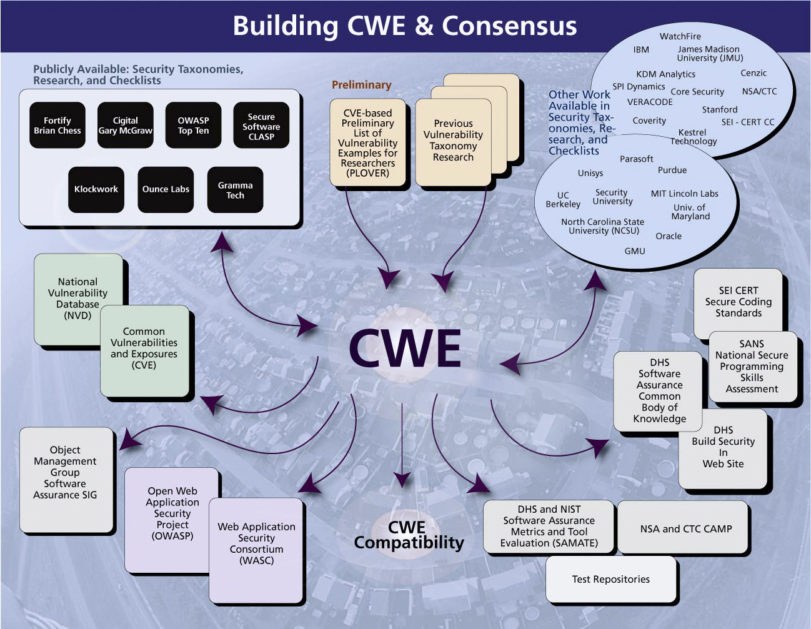
Vulnerabilities & Threats Common Weakness Enumeration (CWE)
CWE is an online dictionary of software weaknesses.
Reference: Common Weakness Enumeration (CWE) (http://cwe.mitre.org/)

Slide 138
Vulnerabilities & Threats 2011 CWE/SANS Top 25 Most Dangerous Programming Errors
Rank | Score | ID | Name
[1] | 93.8 | CWE-89 | Improper Neutralization of Special Elements used in an SQL Command ('SQL Injection')
[2] | 83.3 | CWE-78 | Improper Neutralization of Special Elements used in an OS Command ('OS Command Injection')
[3] | 79.0 | CWE-120 | Buffer Copy without Checking Size of Input ('Classic Buffer Overflow')
[4] | 77.7 | CWE-79 | Improper Neutralization of Input During Web Page Generation ('Cross-site Scripting')
[5] | 76.9 | CWE-306 | Missing Authentication for Critical Function
[6] | 76.8 | CWE-862 | Missing Authorization
[7] | 75.0 | CWE-798 | Use of Hard-coded Credentials
[8] | 75.0 | CWE-311 | Missing Encryption of Sensitive Data
[9] | 74.0 | CWE-434 | Unrestricted Upload of File with Dangerous Type
[10] | 73.8 | CWE-807 | Reliance on Untrusted Inputs in a Security Decision
[11] | 73.1 | CWE-250 | Execution with Unnecessary Privileges
[12] | 70.1 | CWE-352 | Cross-Site Request Forgery (CSRF)
[13] | 69.3 | CWE-22 | Improper Limitation of a Pathname to a Restricted Directory ('Path Traversal')
[14] | 68.5 | CWE-494 | Download of Code Without Integrity Check
[15] | 67.8 | CWE-863 | Incorrect Authorization
[16] | 66.0 | CWE-829 | Inclusion of Functionality from Untrusted Control Sphere
[17] | 65.5 | CWE-732 | Incorrect Permission Assignment for Critical Resource
[18] | 64.6 | CWE-676 | Use of Potentially Dangerous Function
[19] | 64.1 | CWE-327 | Use of a Broken or Risky Cryptographic Algorithm
[20] | 62.4 | CWE-131 | Incorrect Calculation of Buffer Size
[21] | 61.5 | CWE-307 | Improper Restriction of Excessive Authentication Attempts
[22] | 61.1 | CWE-601 | URL Redirection to Untrusted Site ('Open Redirect')
[23] | 61.0 | CWE-134 | Uncontrolled Format String
[24] | 60.3 | CWE-190 | Integer Overflow or Wraparound
[25] | 59.9 | CWE-759 | Use of a One-Way Hash without a Salt
Reference: http://cwe.mitre.org/top25/

Slide 139
Vulnerabilities & Threats Categories of Software Weaknesses
Insecure interaction between components
“Weaknesses related to insecure ways in which data is sent and received between separate components, modules, programs, processes, threats, or systems.”
Risky resource management
“Weaknesses related to ways in which software does not properly manage the creation, usage, transfer, or destruction of important system resources.”
Porous defenses
“Weaknesses related to defensive techniques that are often misused, abused, or just plain ignored.”
Reference: http://cwe.mitre.org/top25/index.html

Slide 140
Vulnerabilities & Threats Reduce / Eliminate Software Vulnerabilities
Addressing structural/design flaws
Understand the information protection needs
Develop use/abuse cases
Define system security requirements
Design system architecture
Develop detailed system design & security controls
Addressing software bugs (weaknesses)
Develop detailed software design & specifications
Implement code reviews
Static code analyzers
Perform tests
Unit, subsystems, system, acceptance tests
Vulnerability scanners
Information Systems Security Engineering (ISSE) Life Cycle
Discover Information Protection Needs | Define Requirements | Design System Architecture | Develop Detailed System Design & Security Controls | Implement System & Security Controls | Continuous Monitoring
McGraw’s Software Security Touch Points
Requirements and Use Cases | Architecture & Design | Test Plans | Code | Test & Test Results | Feedback From The Fields
Focus on software structural defects (flaws)
Focus on software weaknesses (bugs)

Slide 141
Vulnerabilities & Threats Threats to Software – Buffer Overflow …(1/2)
One of the oldest and most common problems to software.
Wagner et. al. estimated over 50% of all vulnerabilities are due to buffer overflow.*
No. 3 in 2011 CWE/SANS Top 25.
A buffer overflow occurs when a program or process tries to store more data in a buffer (temporary data storage area) than it was intended to hold.
In buffer overflow attacks, the extra data may contain codes designed to trigger specific actions, in effect sending new instructions to the attacked computer that could, for example, damage the user's files, change data, or disclose confidential information.
Reference:
* A First Step Towards Automated Detection of Buffer Over-run Vulnerabilities, D. Wagner, et. al., 2000.
2011 CWE/SANS Top 25 Most Dangerous Programming Errors, MITRE, September 2011.

Slide 142
Vulnerabilities & Threats Threats to Software – Buffer Overflow …(2/2)
Recommended countermeasure to prevent buffer overflow attacks:
Patch, patch, and patch
Always check for inputs. Enforce controls at the interfaces
Ensure applications are not exposed to faulty components
Use language and frameworks that are relatively “immune” to buffer overflows:
Language/ Environment | Compiled / Interpreted | Strongly Typed | Direct Memory Access | Safe/ Unsafe
Java, JVM | Both | Yes | No | Safe
.NET | Both | Yes | No | Safe
Perl | Both | Yes | No | Safe
Python | Interpreted | Yes | No | Safe
Ruby | Interpreted | Yes | No | Safe
C/C++ | Compiled | No | Yes | Unsafe
Assembly | Compiled | No | Yes | Unsafe
COBOL | Compiled | Yes | No | Safe
Reference: Buffer Overflows – OWASP (https://www.owasp.org/index.php/Buffer_Overflows) (5/14/12)
Notes:
“Strongly typed” means the language has some restrictive rules for variables, syntax, and pointers to memory.

Slide 143
Vulnerabilities & Threats Threats to Software – Cross-site Scripting (XSS) …(1/2)
XSS is one of the most prevalent web application (web app) security flaw.
No. 4 in 2011 CWE/SANS Top 25 and OWASP Top 10.
XSS occurs when a web app in web browser accepts “untrusted data” and sends it to a web app server without proper validation. Attackers can then execute scripts in a victim’s web browser to hijack user sessions, deface web sites, insert malicious content, redirect users, etc.
These “untrusted data” could be JavaScript, or other browser-executable RIA contents such as Active X, Flash, Silverlight, etc.
Reference: CWE-79: Improper Neutralization of Input During Web Page Generation (Cross-site Scripting) (http://cwe.mitre.org/data/definitions/79.html) (6/2/2013).
Notes:
None Persistent:
Alice often visits a particular website, which is hosted by Bob. Bob's website allows Alice to log in with a username/password pair and store sensitive data, such as billing information.
Mallory observes that Bob's website contains a reflected XSS vulnerability.
Mallory crafts a URL to exploit the vulnerability, and sends Alice an email, enticing her to click on a link for the URL under false pretenses. This URL will point to Bob's website, but will contain Mallory's malicious code, which the website will reflect.
Alice visits the URL provided by Mallory while logged into Bob's website.
The malicious script embedded in the URL executes in Alice's browser, as if it came directly from Bob's server (this is the actual XSS vulnerability). The script can be used to send Alice's session cookie to Mallory. Mallory can then use the session cookie to steal sensitive information available to Alice (authentication credentials, billing info, etc.) without Alice's knowledge.
Persistent:
Mallory posts a message with malicious payload to a social network.
When Bob reads the message, Mallory's XSS steals Bob's cookie.
Mallory can now hijack Bob's session and impersonate Bob.

Slide 144
Vulnerabilities & Threats Threats to Software – Cross-site Scripting (XSS) …(2/2)
Recommended countermeasures to prevent XSS attacks:
Never insert untrusted data except in allowed locations.
Use “escaping” (a.k.a. output encoding) technique.
Use an HTML policy engine to validate or clean user-driven HTML in an outbound way.
Prevent DOM-based XSS.
Use “HTTPOnly” cookie flag
Reference:
- CWE-7: Improper Neutralization of Input During Web Page Generation (Cross-site Scripting) (http://cwe.mitre.org/data/definitions/79.html) (6/2/2013)
- XSS (Cross Site Scripting Prevention Cheat Sheet – OWASP (https://www.owasp.org/index.php/XSS_(Cross_Site_Scripting)_Prevention_Cheat_Sheet) (5/14/12)
Notes:
Learn “regular expressions”
“Output encoding” is a technique for encoding inputs and translate them back into system commands
“HTML escape” before inserting untrusted data into HTML element content. (http://code.google.com/p/owasp-esapi-java/source/browse/trunk/src/main/java/org/owasp/esapi/codecs/HTMLEntityCodec.java)
“Attribute escape” before inserting untrusted data into HTML common attributes.
“JavaScript escape” before inserting untrusted data into JavaScript data values.
“CSS escape” and strictly validate before inserting untrusted data into HTML style property values.
“URL escape” before inserting untrusted data into HTML URL parameter values.

Slide 145
Vulnerabilities & Threats Threats to Software – SQL Injection …(1/3)
In 2011, SQL Injection is No.1 in both CWE/SANS Top 25 and OWASP Top 10.
SQL injection occurs when an application sends “untrusted data” to an interpreter as a part of command or query.
These “untrusted data” can be in SQL queries, LDAP queries, Xpath queries, etc.
Attackers can:
Alter the logic of SQL queries to bypass security (e.g., authentication, authorization, etc.) to gain unauthorized access to data (e.g., steal, corrupt, or change data.)
Trick the interpreter to execute unintended commands
Reference: CWE-89: Improper Neutralization of Special Elements used in an SQL Command (SQL Injection) (http://cwe.mitre.org/top25/#CWE-89) (6/2/2013)
Notes:
http://xkcd.com/327/

Slide 146

Vulnerabilities & Threats Threats to Software – SQL Injection …(2/3)
Reference: Exploits of a Mom http://xkcd.com/327/) (5/14/12)

Slide 147
Vulnerabilities & Threats Threats to Software – SQL Injection …(3/3)
Recommended countermeasures to prevent SQL injection attacks:
Use “prepared statements” (/ parameterized queries) such as:
Java EE – use PreparedStatement() with bind variables
.NET – use parameterized queries like SqlCommand() or OleDbCommand() with binding variables
PHP – use PDO with strongly typed parameterized queries (use binParam())
Use stored procedures
Escaping all “user supplied” inputs. Treat user inputs as untrusted data, don’t insert them directly as a part of a SQL query
Reference: SQL Injection Prevention Cheat Sheet – OWASP (https://www.owasp.org/index.php/SQL_Injection_Prevention_Cheat_Sheet) (5/14/12)
Notes:
Learn “regular expressions”

Slide 148
Vulnerabilities & Threats Threats to Software – OS Command Injection
OS Command Injection (a.k.a. Shall Injection) is #2 in 2011 Top 25 CWE.
Attacker injects and execute unwanted system commands through vulnerable applications that lacks proper input data validation (e.g., forms, cookies, HTTP headers etc.)
As with SQL Injection, it is a variant of Code Injection attack, except it utilizes applications running as “system” instead of “user”.
Recommended countermeasure:
Validate inputs
Use application provided API
Run automated code analysis tools
Reference: CWE-78: Improper Neutralization of Special Elements used in an OS Command (http://cwe.mitre.org/data/definitions/78.html) (6/2/2013)

Slide 149
Vulnerabilities & Threats Use of Automated Analysis Tools
For detection of structural flaws (“defects”)
Tool integration frameworks (a.k.a. IDEs)
Software engineering management, architecture/ design modeling (MBSE), requirements traceability, design patterns
Code quality review tools
For detection of software weakness (“bugs”)
Static code analysis tools
Source code security analyzers, byte code scanners, binary code scanners
Dynamic analysis tools
Web application vulnerability scanners, database vulnerability scanners
Network vulnerability scanners
SCAP-compatible security configuration scanners
Information Systems Security Engineering (ISSE) Life Cycle
Discover Information Protection Needs | Define Requirements | Design System Architecture | Develop Detailed System Design & Security Controls | Implement System & Security Controls | Continuous Monitoring
Software Development: Rational Unified Process
Inception |  | Elaboration |  | Construction |  | Transition
Business Modeling | Requirements | Analysis & Design |  | Implementation |  | Deployment/CM
McGraw’s Software Security Touch Points
Requirements and Use Cases |  | Architecture & Design | Test Plans | Code | Test & Test Results | Feedback From The Fields
Focus on software structural defects (flaws)
Focus on software weaknesses (bugs)

Slide 150
Vulnerabilities & Threats Malicious Code / Malware
Malicious code / malware (MALicious softWARE)
For CISSP, there are many types of “malware”:
Viruses
Worms
Trojan horses
Rootkits
Spyware
Some cookies…
Reference: http://youtu.be/cf3zxHuSM2Y

Slide 151
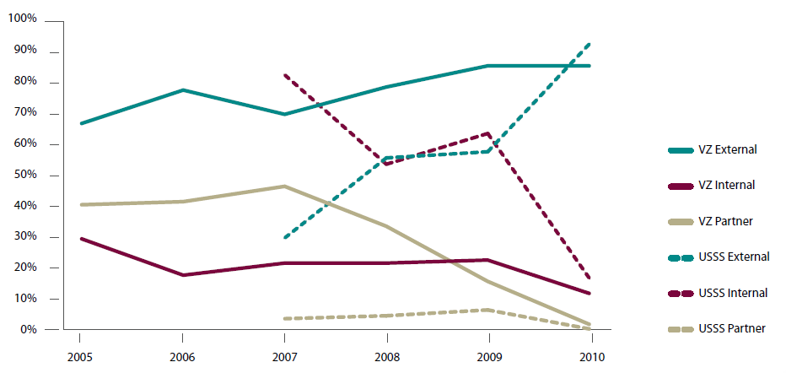
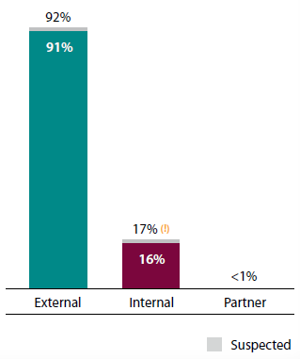
Vulnerabilities & Threats Malware as a Threat to Information Operations …(1/3)
Operations are getting better at addressing insider threats…
VZ (Verizon)
USSS (United States Secret Service)
The fact is that most of threats are still from external threat agents.
Reference: 2011 Data Breach Investigations Report, Verizon, January 2012 (http://www.verizonbusiness.com/resources/reports/rp_data-breach-investigations-report-2011_en_xg.pdf)

Slide 152
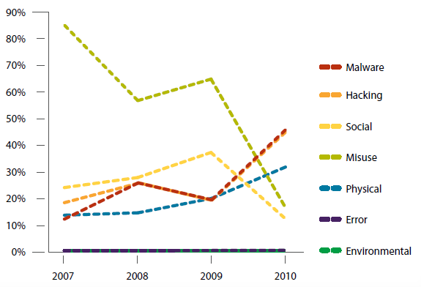
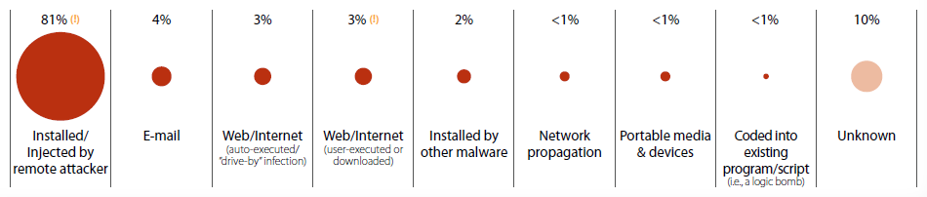
Vulnerabilities & Threats Malware as a Threat to Information Operations …(2/3)
Most of data breaches are from hacking and malware...
Majority of malware are installed remotely...
Reference: 2011 Data Breach Investigations Report, Verizon, January 2012 (http://www.verizonbusiness.com/resources/reports/rp_data-breach-investigations-report-2011_en_xg.pdf)

Slide 153
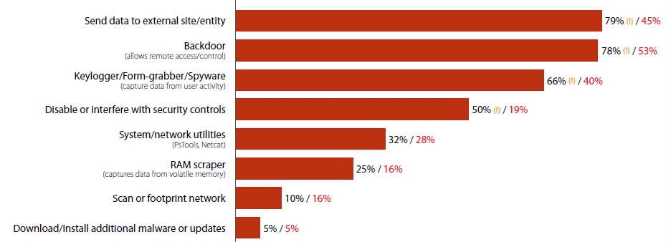
Vulnerabilities & Threats Malware as a Threat to Information Operations …(3/3)
Advanced Persistent Threat (APT) is very real
Malware is now a tool for hackers
They are stealing data...
Reference: 2011 Data Breach Investigations Report, Verizon, January 2012 (http://www.verizonbusiness.com/resources/reports/rp_data-breach-investigations-report-2011_en_xg.pdf)

Slide 154
Vulnerability & Threats Threats to Software – Malicious Code / Malware
Malicious code / malware (MALicious softWARE)
Virus – A program or piece of code that is loaded onto your computer without your knowledge and runs against your wishes. Viruses can also replicate themselves. A simple virus that can make a copy of itself over and over again is relatively easy to produce.
Polymorphic virus – A virus that changes its virus signature (i.e., its binary pattern) every time it replicates and infects a new file in order to keep from being detected by an antivirus program.
Notes:
Malware, Page 1016

Slide 155
Vulnerability & Threats Threats to Software – Malicious Code / Malware
Boot sector virus – A boot sector virus is a common type of virus that replaces the boot sector with its own code. Since the boot sector executes every time a computer is started, this type of virus is extremely dangerous.
Macro virus – A type of computer virus that is encoded as a macro embedded in a document. Many applications, such as Microsoft Word and Excel, support powerful macro languages. These applications allow you to embed a macro in a document, and have the macro execute each time the document is opened.
According to some estimates, 75% of all viruses today are macro viruses. Once a macro virus gets onto your machine, it can embed itself in all future documents you create with the application.

Slide 156
Vulnerability & Threats Threats to Software – Malicious Code / Malware
Worm – A program or algorithm that replicates itself over a computer network and usually performs malicious actions. Differ from viruses in that they are self contained and do not need a host application to reproduce.
Logic bomb – Also called slag code, programming code (typically malicious) added to the software of an application or operating system that lies dormant until a predetermined period of time or event occurs, triggering the code into action.

Slide 157
Vulnerability & Threats Threats to Software – Malicious Code / Malware
Trojan horse – A destructive program that masquerades as a benign application. Unlike viruses, Trojan horses do not replicate themselves but they can be just as destructive. One of the most insidious types of Trojan horse is a program that claims to rid your computer of viruses but instead introduces viruses onto your computer.
Data diddler – refers to the payload in a Trojan or virus that deliberately corrupts data, generally by small increments over time.
Hoax – usually warnings about viruses that do not exist, generally carry a directive to the user to forward the warning to all addresses available to them.
Trapdoor/backdoor – can also be called a maintenance hook; it’s a hidden mechanism that bypasses access control measures.

Slide 158
Validation Time… ☺
Classroom Exercise
Review Answers

Slide 159
Classroom Exercise: Constructing a Security Engineering Project… (1/5)
Systems Engineering (SE) Activities | Security Engineering (ISSE) Activities
Discover Mission/Business Needs The SE helps the customer understand and document the information management needs that support the business or mission. Statements about information needs may be captured in an information management model (IMM). | Discover Information Protection Needs The ISSE facilitates the system owners, architects, and engineers in assessing the information protection needs by performing risk assessment, capturing the information management model (IMM), defining the information protection policy (IPP) and compile them into a comprehensive information management plan (IMP).
Define System Requirements The SE allocates identified needs to systems. A system context is developed to identify the system environment and to show the allocation of system functions to that environment. A preliminary system Concept of Operations (CONOPS) is written to describe operational aspects of the candidate system (or systems). Baseline requirements are established. | Define System Security Requirements The ISSE allocates the information protection needs in accordance with the information management plan (IMP) that aligns with a preliminary system security concept of operations (CONOPS) and generates a set of baseline security requirements in accordance with FIPS 200.
Design System Architecture The SE performs functional analysis and allocate by analyzing candidate architectures, allocating requirements, and selecting mechanisms. The system engineer identifies components or elements, allocates functions to those elements, and describes the relationships between the elements. | Design System Security Architecture The ISSE works in conjunction with system architect and engineers in defining a system architecture using the designated system architecture framework to explain the system architecture at the conceptual and logic levels in meeting the defined baseline security requirements.

Slide 160
Classroom Exercise: Constructing a Security Engineering Project… (2/5)
Systems Engineering (SE) Activities | Security Engineering (ISSE) Activities
Develop Detailed System Design The SE analyzes design constrains, analyzes trade-offs, does detailed system design, and considers life-cycle support. The systems engineer traces all of the system requirements to the elements until all are addressed. The final detailed design results in component and interface specifications that provide sufficient information for acquisition where the system is implemented. | Develop Detailed Security Design The ISSE analyzes the design constrains, trade-offs from the system architecture and begin to work with system architect and engineers to define detailed system design.
Implement System The SE moves the system from specifications to the tangible. The main activities are acquisition, integration, configuration, testing, documentation, and training. Components are tested and evaluated to ensure that they must meet the specifications. After successful testing, the individual components – hardware, software, and firmware – are integrated, properly configured, and tested as a system. | Implement System Security The ISSE works with SE in implementing the baseline detailed system design. The information systems security engineer provide inputs to the certification and accreditation (C&A) process and verify the implemented system design meets the defined baseline security requirements against the identified threats .
Assess System Effectiveness The results of each activity are evaluated to ensure that the system will meet the user’s needs by performing the required functions to the required quality standard in the intended environment. The systems engineer examines how well the system meets the needs of the mission. | Assess System Security Effectiveness The ISSE focuses on the effectiveness of the implemented security controls and countermeasures, and validates them against the defined information management plan (IMP).

Slide 161
Classroom Exercise: Constructing a Security Engineering Project… (3/5)
Discovering the Information Protection Needs
1.1 Collect & analyze system information: Business/Mission Needs, high-level concept of information operations, data sensitivity, mode of operations, etc.
1.2 Perform Risk Assessment of the “to-be” information system
1.3 Generate Information Management Model (IMM)
1.4 Generate Information Protection Policy (IPP)
1.5 Assemble Information Management Plan
Defining the System Security Requirements
2.1 Define security context description (i.e. scope)
2.2 Generate system security requirements: functional & assurance

Slide 162
Classroom Exercise: Constructing a Security Engineering Project… (4/5)
Designing the System Security Architecture
3.1 Describe the Conceptual Security Architecture
3.2 Describe the Logical Security Architecture
3.3 Describe the Physical Security Architecture
Developing the Detailed System Security Design
4.1 Describe the Security Architecture at the components level
4.1.1 Defending the Network & Infrastructure
4.1.2 Defending the Enclave Boundary
4.1.3 Defending the Computing Environment
4.1.4 Supporting the IT Infrastructure

Slide 163
Classroom Exercise: Constructing a Security Engineering Project… (5/5)
Implementing the System Security
5.1 Implement system design for defending the network infrastructure
5.2 Implement system design for defending the enclave boundary
5.3 Implement system design for defending the computing environment
5.4 Implement system design for supporting the IT Infrastructure
Assessing the Security Effectiveness
6.1 Perform analysis on Security Requirements Traceability matrix (S-RTM)
6.2 Verify conformance of system design to S-RTM
6.3 Validate security implementation to S-RTM
6.4 Support Security Certification & Accreditation (C&A) Team

Slide 164
Group 1: Waterfall SDLC Model

Slide 165
Group 1: Waterfall SDLC Model

Slide 166
Group 2: DoD-STD-2167A (V-Model)

Slide 167
Group 2: DoD-STD-2167A (V-Model)

Slide 168
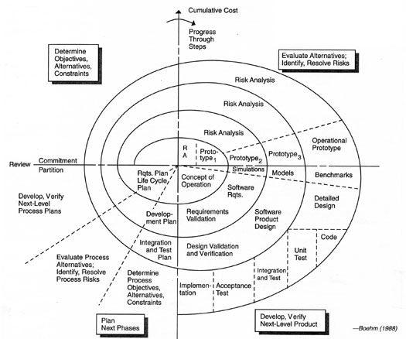
Group 3: Boehm’s Spiral SDLC Model

Slide 169
Group 3: Boehm’s Spiral SDLC Model

Slide 170
Answers
Reference

Slide 171
Group 1: Waterfall SDLC Model

Slide 172
Group 2: DoD-STD-2167A (V-Model)

Slide 173
Group 3: Boehm’s Spiral SDLC

